Slide 1

Online Basic Training Session #1
Preparing to Lead!

Slide 2
What are the goals of this training?
Walk through steps for implementation
Answer questions
Provide understanding of DL philosophy
Equip to execute each part of the program – both the “why” and the “how”
Give the tools needed to train others

Slide 3
What we are covering in this session:
DL Vision and Philosophy
Volunteer Structure
The importance of children’s ministry
Who is Discovery Land Global?
Curriculum overview
Components of the program

Slide 4


Slide 5
The importance of children’s ministry
God loves and values children
The Bible tells us to do it
Childhood is a spiritually critical time of life
Children’s ministry has a far reach

Slide 6
Key components of effective child discipleship
Gospel- and Bible-centered
A clear vision and plan
Trained leaders and disciplers that are a part of a larger team and network
Curriculum and resources that are engaging for kids
Church-wide involvement and support (resources, encouragement, prayer)

Slide 7
What is Discovery Land?
Christian education program for local churches
Designed to “Discover Eternal Treasures” in God’s Word
Fun, engaging, and effective

Slide 8
What is Discovery Land?
Specializes in using hands-on learning techniques and encourages kids to apply what they’ve learned
Strategic and purposeful
Considers the spiritual development of children beginning at six months of age and continuing through their transition to middle school ministry

Slide 9
DL Curriculum is Designed to Teach Students:
The Bible: the big picture of the Old Testament and New Testament as a whole, unified revelation of God’s truth to us
The Gospel of Jesus: salvation by grace through faith as presented throughout the entire Bible
The Basics of Christianity: life transformation through
  Prayer
  Worship
  Evangelism
  Scripture memory
  Baptism, etc.

Slide 10

Proverbs 2:1-11

Slide 11
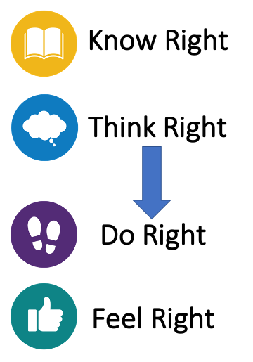
4 Rights
Biblical Worldview

Slide 12
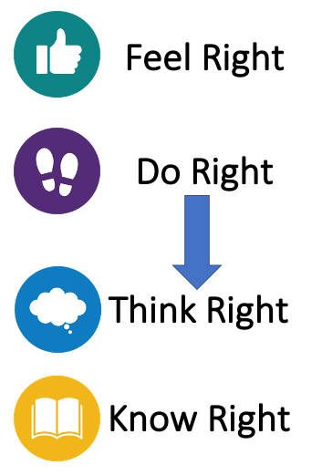
4 Rights
Secular Worldview

Slide 13
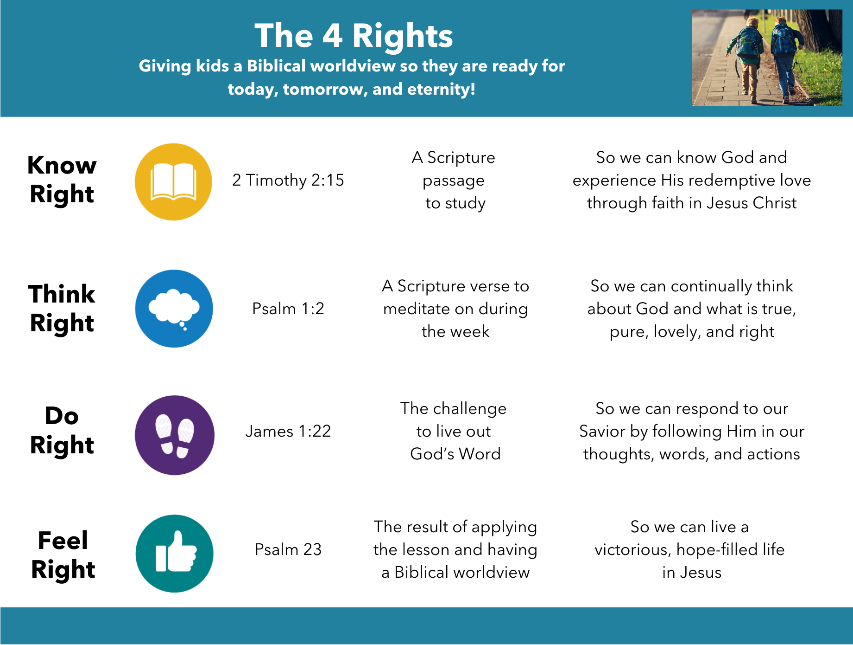

Slide 14
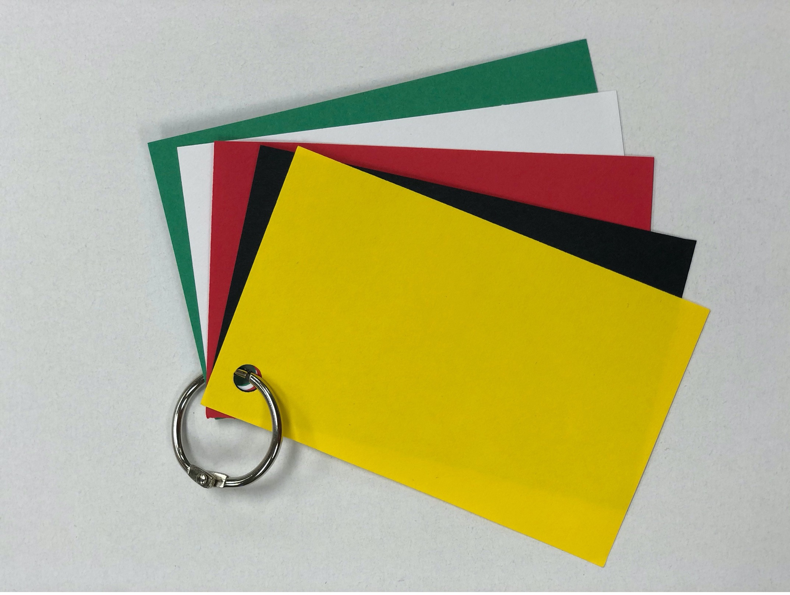
The Gospel

Slide 15

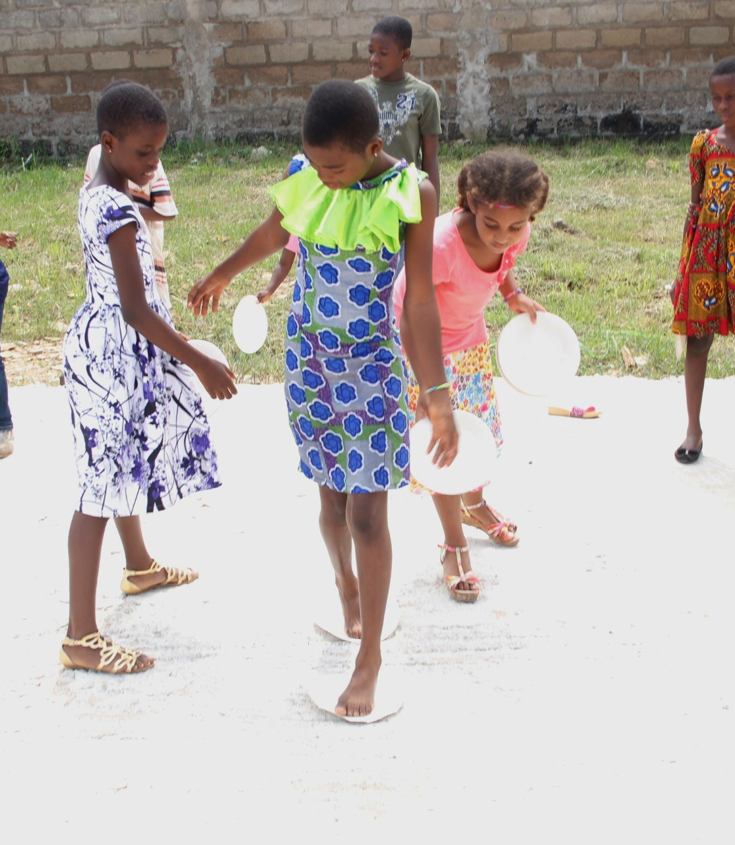
Curriculum Overview
Age Breakdowns:
  Crawlers (6 month olds)
  Walkers (1 year olds)
  Runners (2 year olds)
  Preschool (3 and 4 year olds)
  Elementary (Kindergarten – 5th grade)
  6th grade
  K-2nd Large Group Times
With a DL Global membership, you receive access to all curriculum and resources.
Everything is downloadable and available in the member’s area of the website.

Slide 16
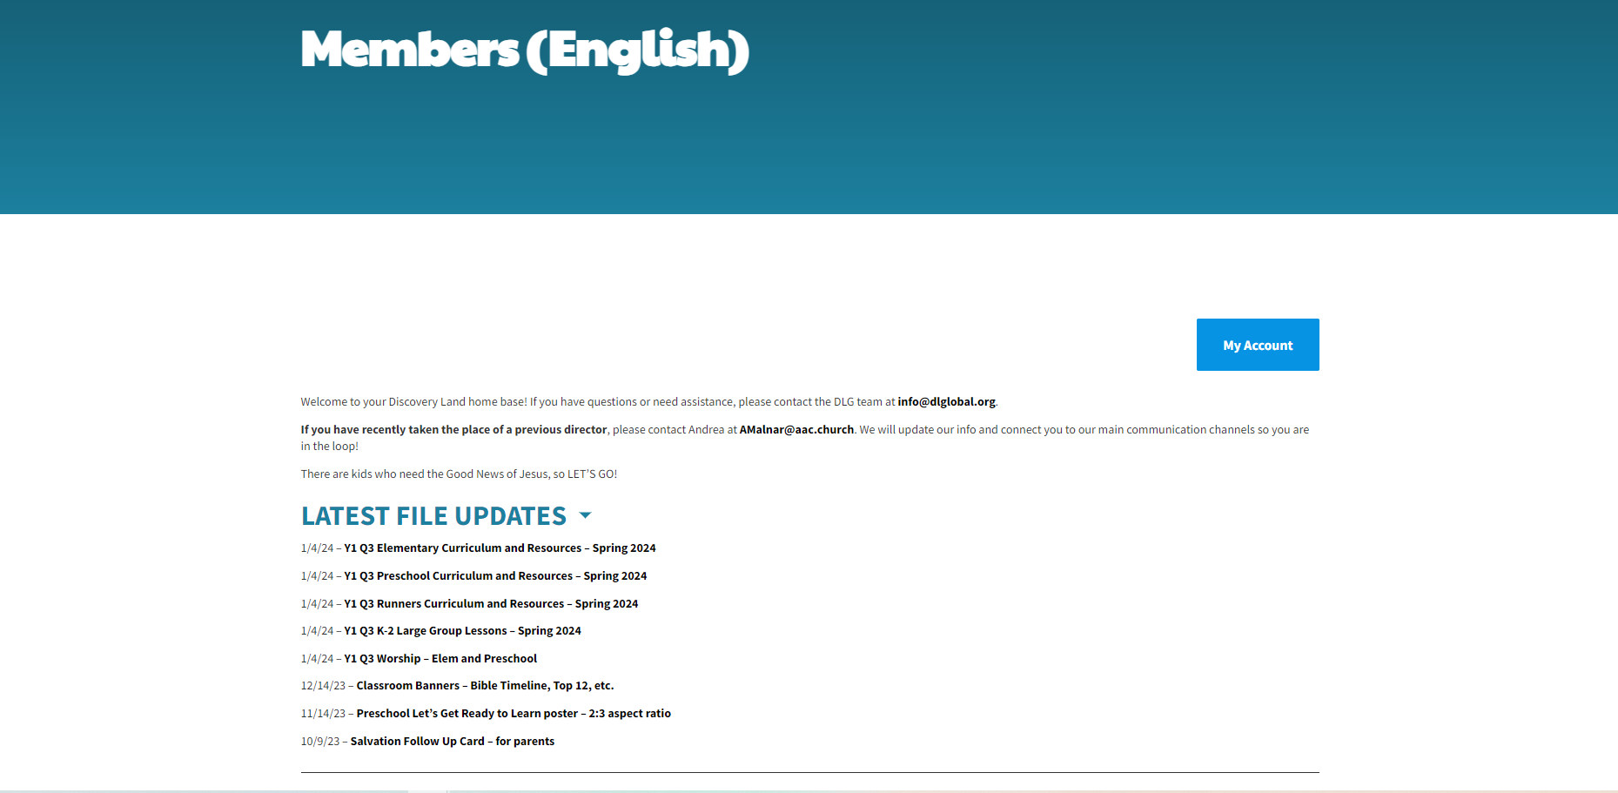
Curriculum Overview
Crawlers, Walkers, and 6th grade curriculum each have their own scope and sequence.
3-year scope and sequence for Runners, Preschool, and Elementary curriculum.
  Dated weekly lessons
  Divided into quarters
  Released 1-2 months prior to the first Sunday of the quarter
  Downloadable and available in the member’s area of the website.

Slide 17
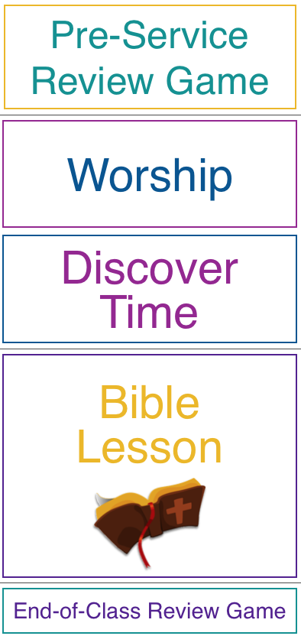

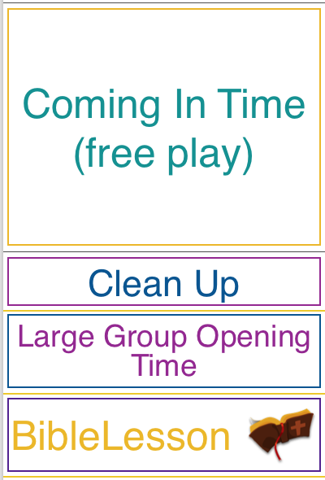
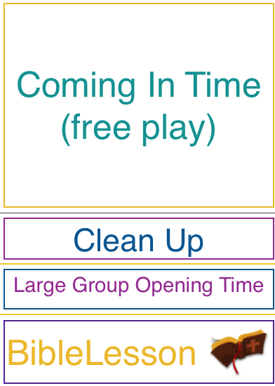

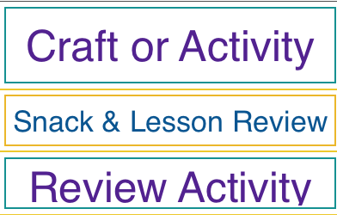
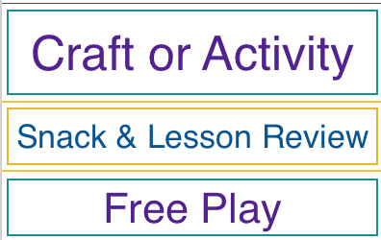

Components of the Program
Elementary (K-5)
Preschool (3s & 4s)
Runners (2s)
Walkers (1s)

Slide 18
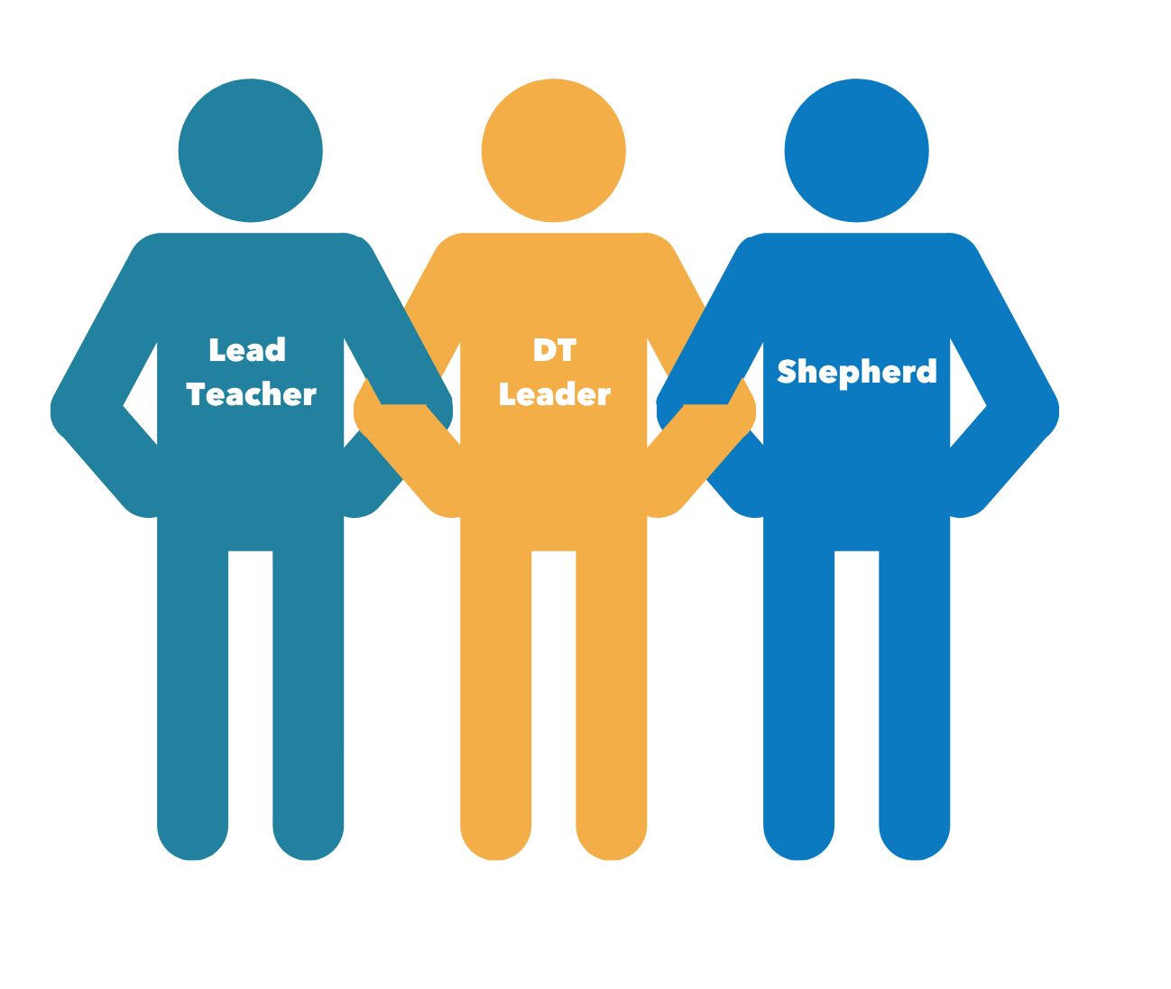
Volunteer Structure
Lead
Teacher
DT Leader
Shepherd

Slide 19
Online Basic Training Session #2
Preparing to Lead!

Slide 20
What we are covering
Pre-Service Review Game
Worship through music
Discover Time
Top 12 Verses
Tracker Tickets/Discover Market
Review - Program components/schedule

Slide 21
Review - Components of the Program
Elementary (K-5)
Preschool (3s & 4s)
Runners (2s)
Walkers (1s)

Slide 22
Sample Schedule (1 hour)
Elementary (K-5)
SUGGESTED SCHEDULE
-:20 Volunteers ready and prepared to welcome students as they arrive
-:15 Pre-Service Review Game
:00 Worship
:15 Discover Time
:30 Bible Lesson
:60 End-of-Class Review Game
:65 Parents pick up students

Slide 23
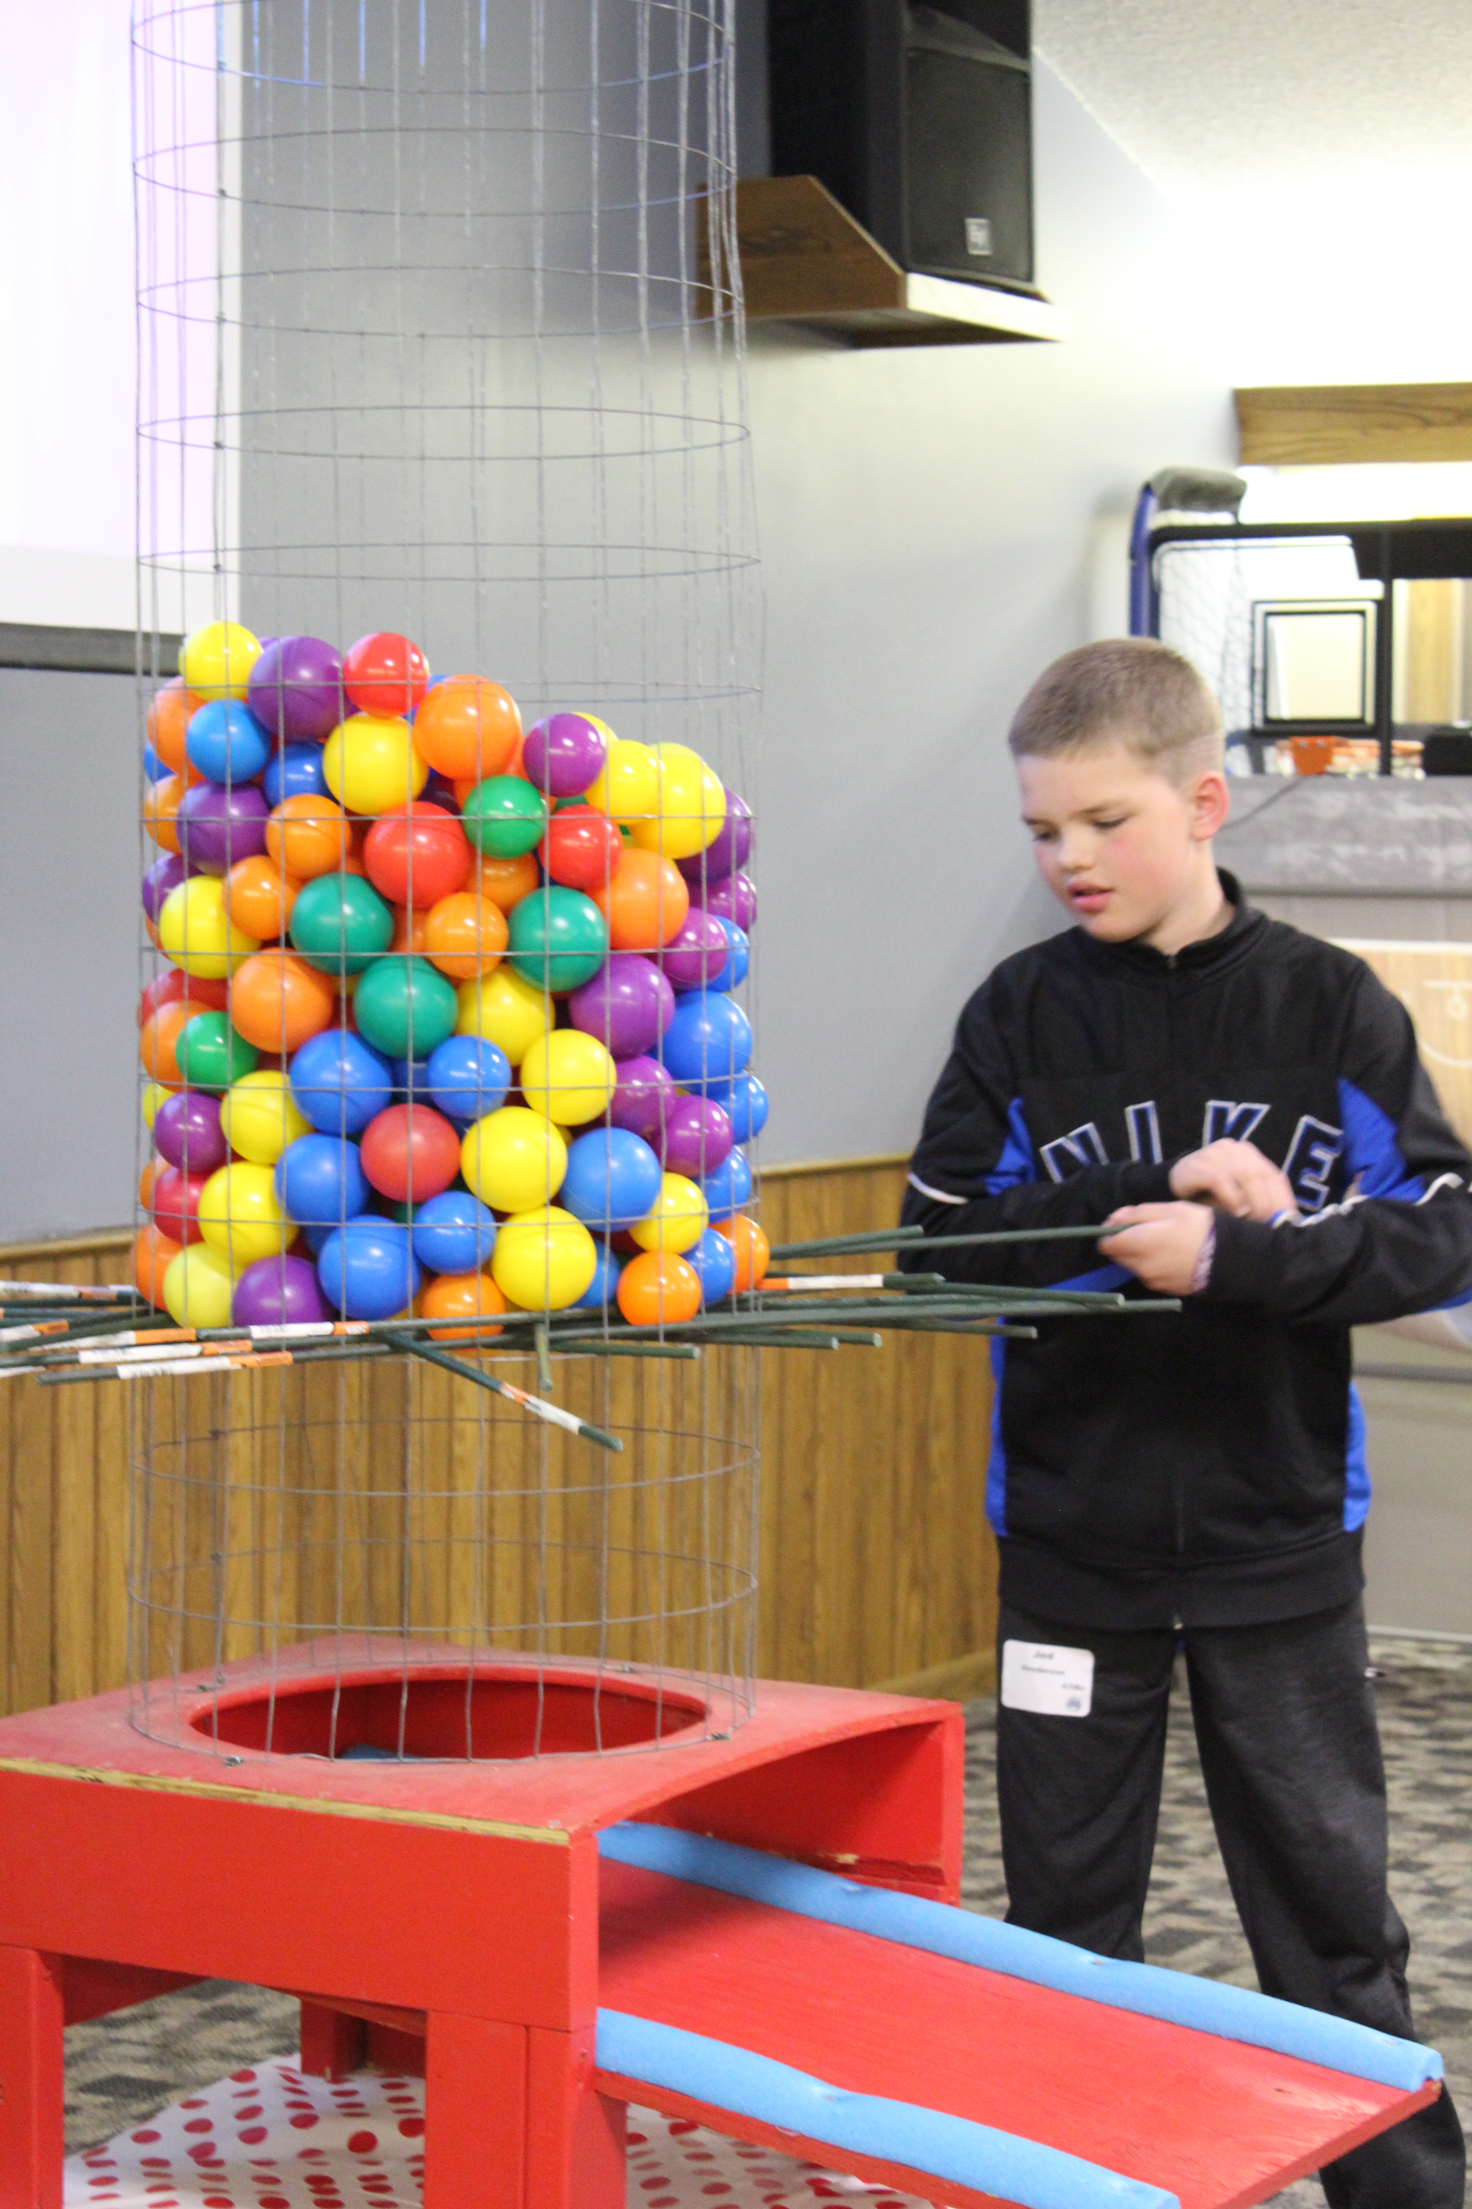
Pre-Service Review Game
WHAT
A fun, high-energy review game played as students arrive.
WHY
Reclaims potentially wasted time:
  Total Time Teaching
  Parent perception
  Review and reinforcement
HOW
Ideas available each quarter
All leaders participate
TIPS FOR IMPLEMENTATION
Everything can be adapted – use what you have
Make it visually exciting
For smaller groups: work together instead of teams
Adjust questions as needed
It’s not a test! All kids should be included

Slide 24
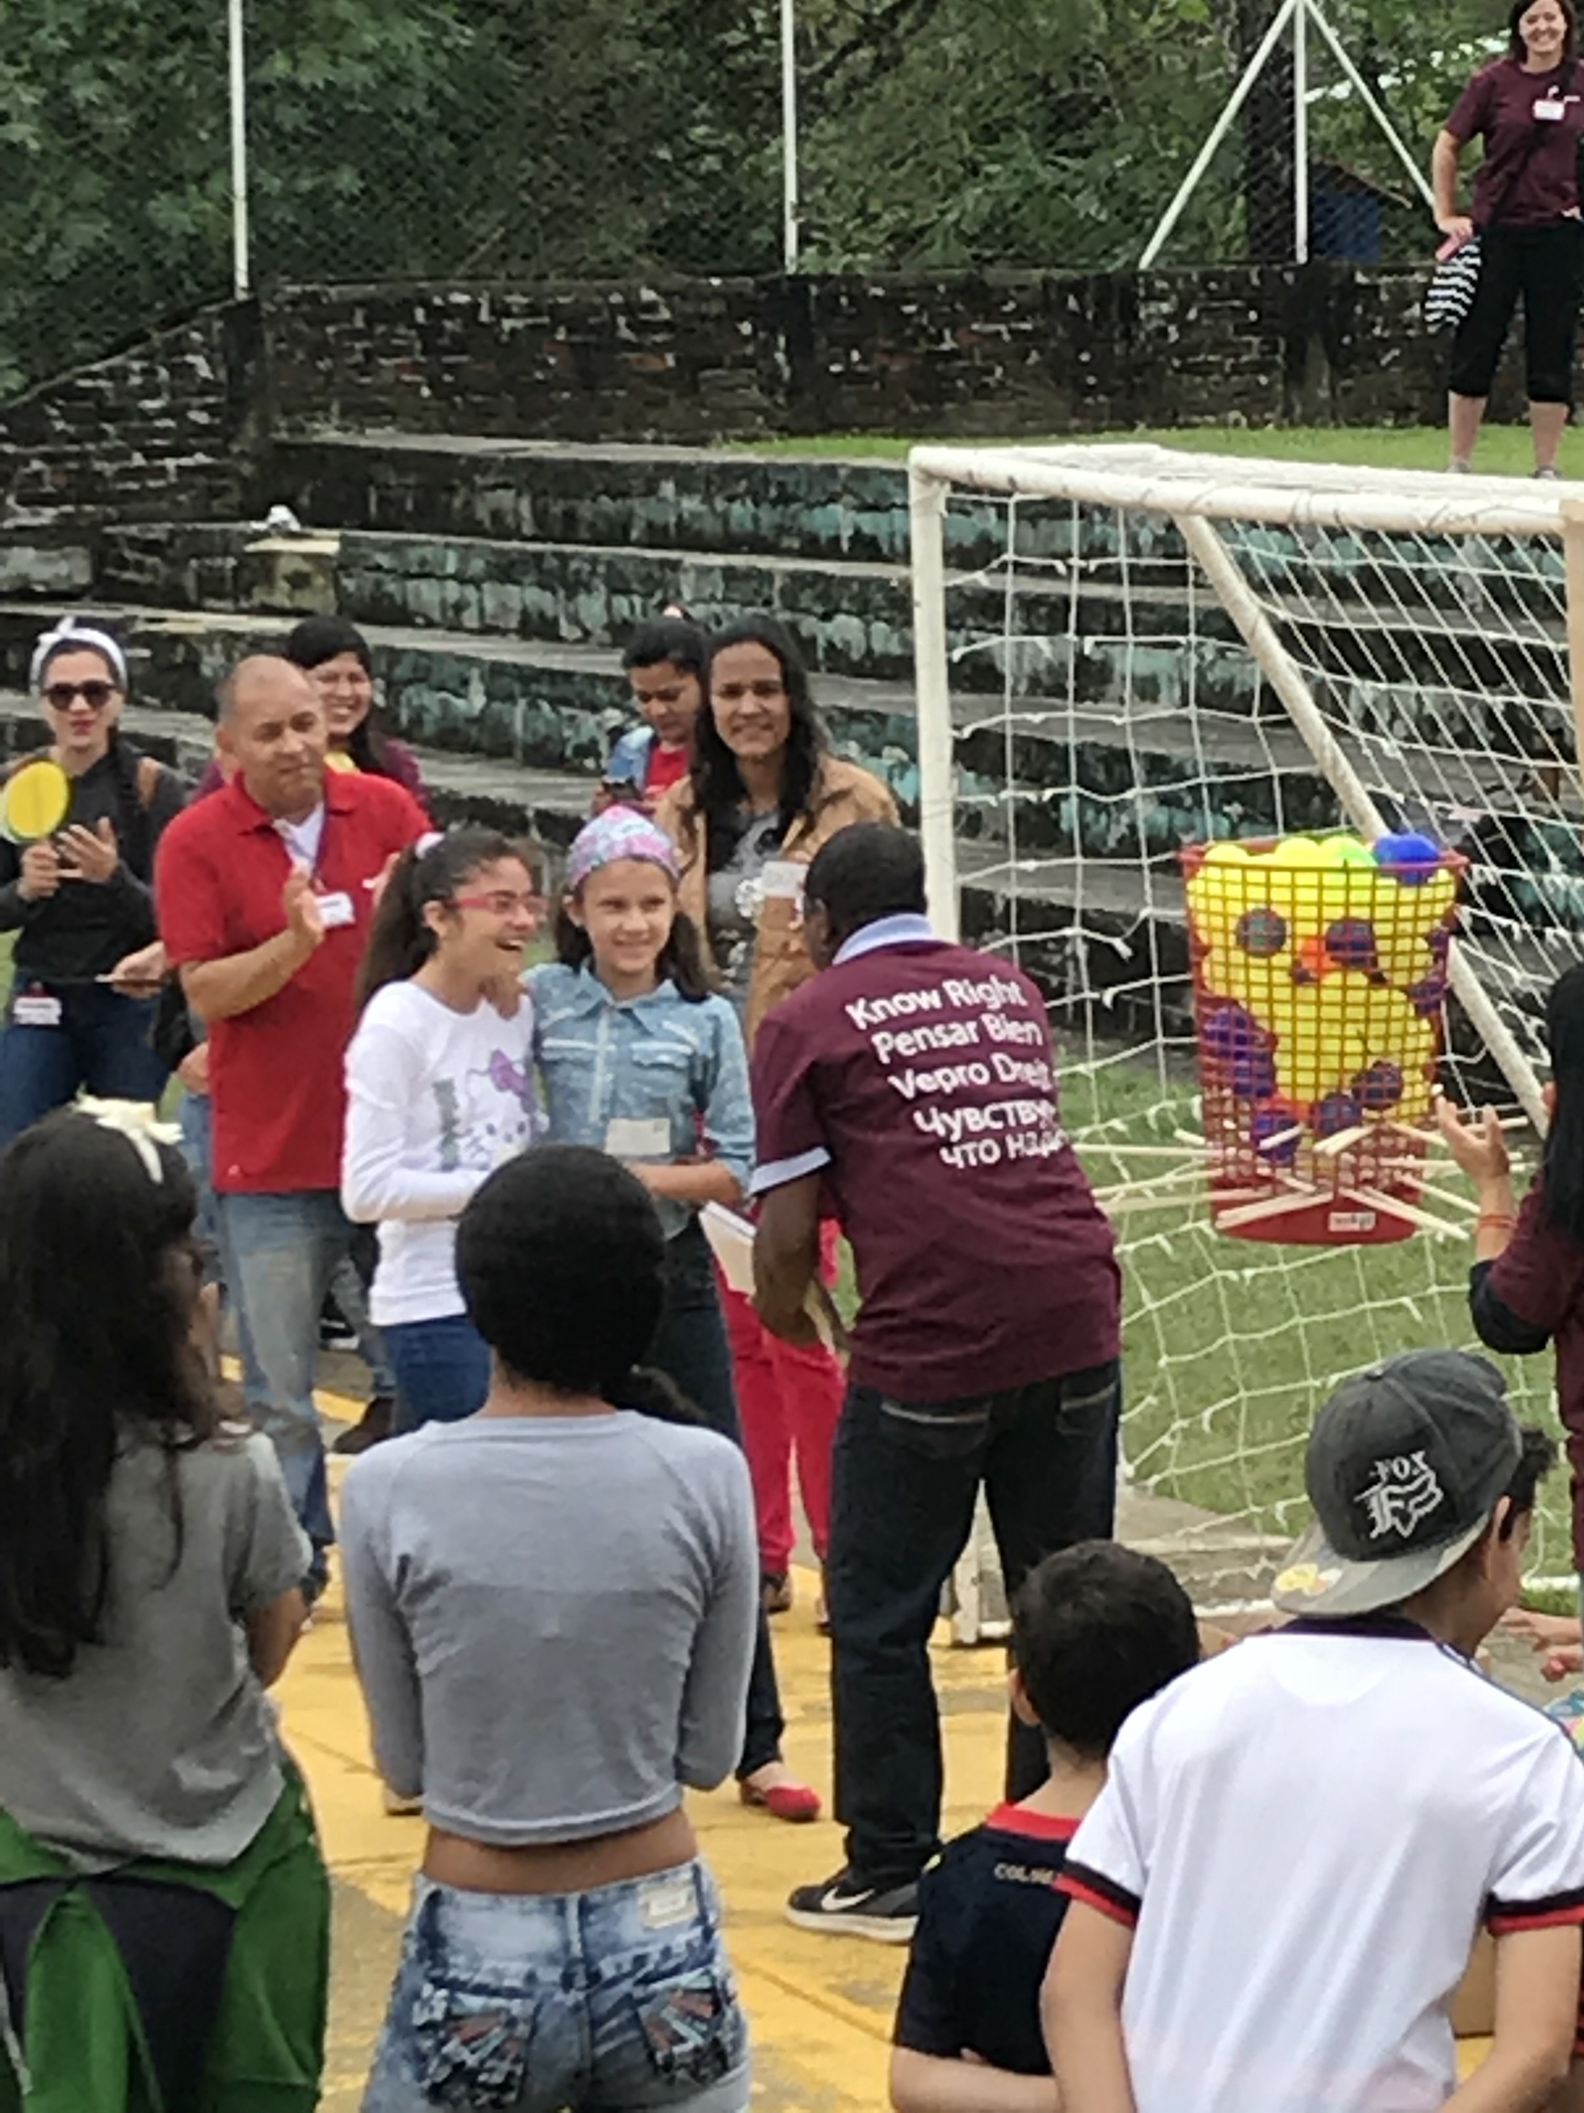
Same game… different country!

Slide 25
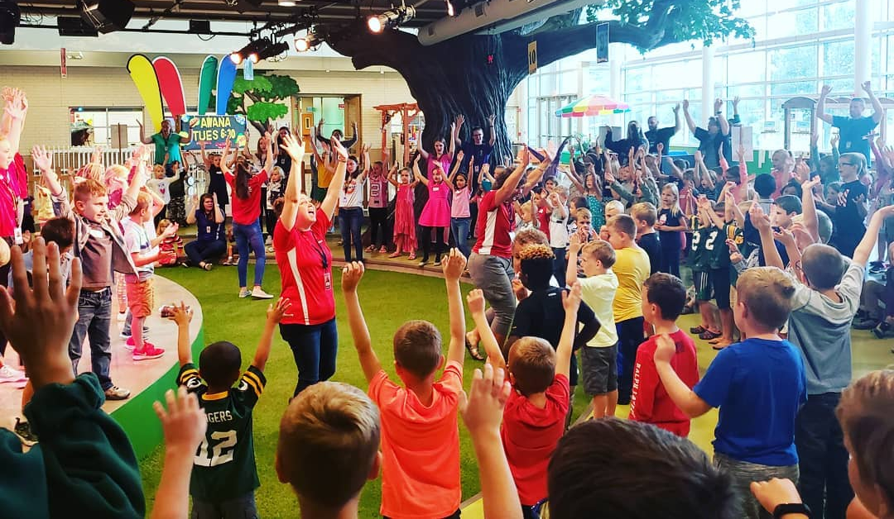
Worship through music
WHAT
An opportunity for students to worship through song and motion.
WHY
Introduce the lesson of the day
Teach what worship is
Model authentic worship
Encourage participation in worship
HOW
2-3 songs per week
All leaders participate
Suggested song list, schedule, and transitions (song introductions) are available in the appendix of each quarter
Worship and hand motion training videos on DL website
TIPS FOR IMPLEMENTATION
Pray for passionate, energetic worship leaders
Great way to get teen leaders involved
Music is very cultural – adapt for your church as needed

Slide 26
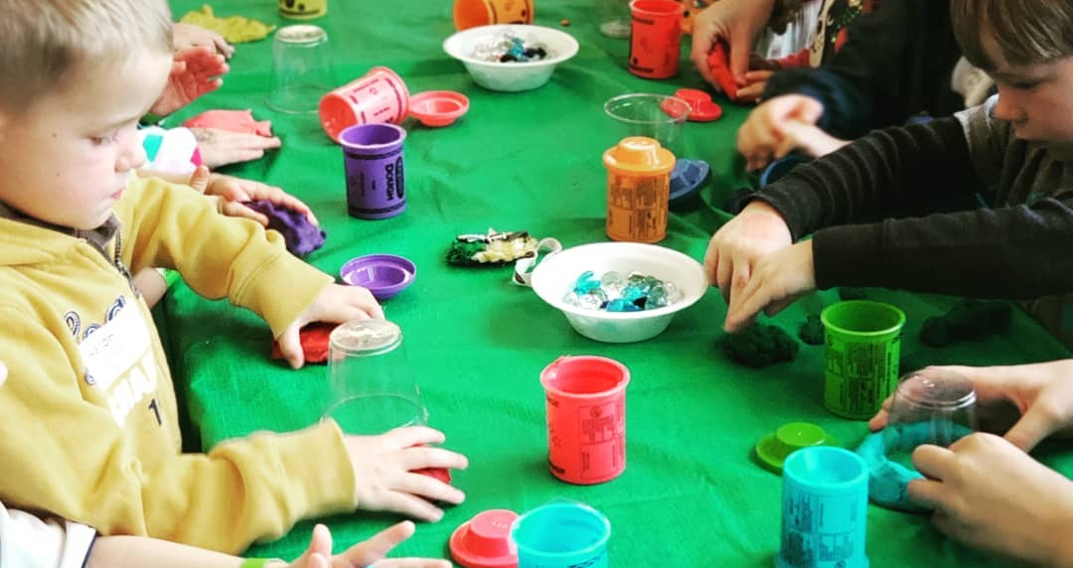
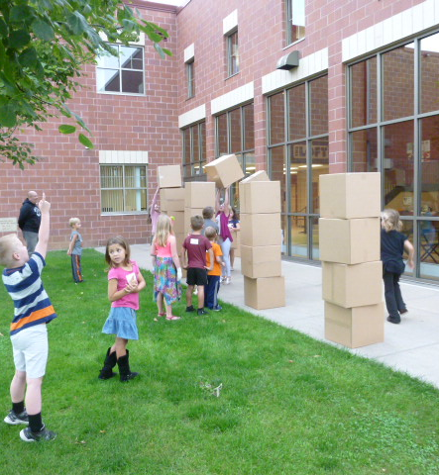
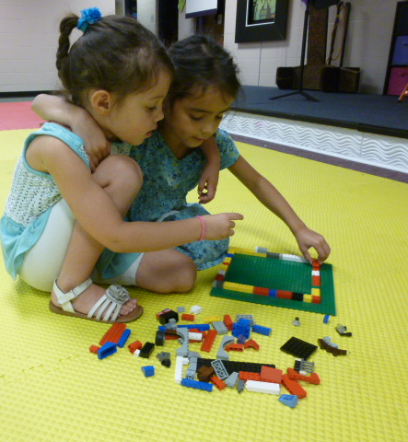
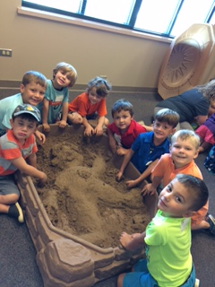
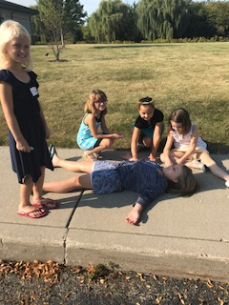
Discover Time

Slide 27
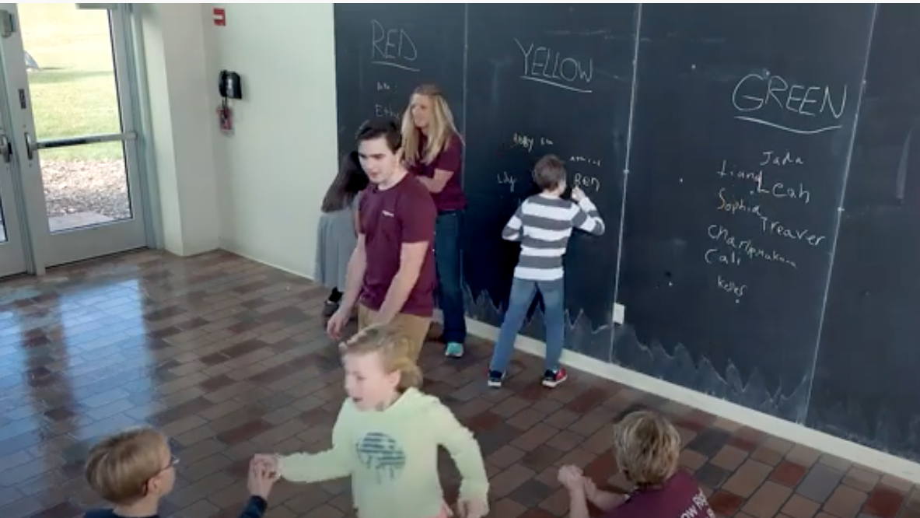
The Discover Time Video Demo

Slide 28

Discover Time
Designed to engage kids and introduce the lesson (or reinforce an idea) through hands on learning – it’s an object lesson that kids participate in!
DT Stations: Sand, Water, Lego, Food, Play-Doh, Boxes, Art, Obstacle Courses, Missions
  Weekly rotation (one station per class per week)
  Directors choose which station(s) to use
  Quarter 4 (summer) is one big DT, no stations, typically outdoor
Elementary: often competitive
Preschool: non-competitive

Slide 29
Discover Time
Critical for both the DT Leader and the setup person to understand the goal of the DT AND to think through the entire activity step-by-step
All leaders participate
Winners and losers
Keep the FUN in Discover Time!

Slide 30
Discover Time
How to Train DT Leaders – examples, examples, examples
Need help adapting? Contact us!

Slide 31
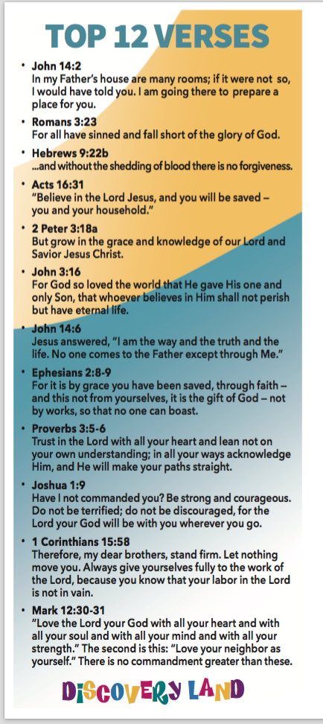
Top 12 Verses
12 key verses that are woven throughout the curriculum
Goal is memorization, understanding, and life application
Like stacking blocks – we start in Runners (2 year olds) and keep building
Leaders memorize them first!
Then challenge your kids to memorize them

Slide 32

Tracker Tickets
Incentive system and discipleship tool to build in excitement, motivation, disciplines
Elementary only
Shepherds take the lead
Follow the instructions during DT (winners and losers!)
Can spend them at the Discover Market

Slide 33
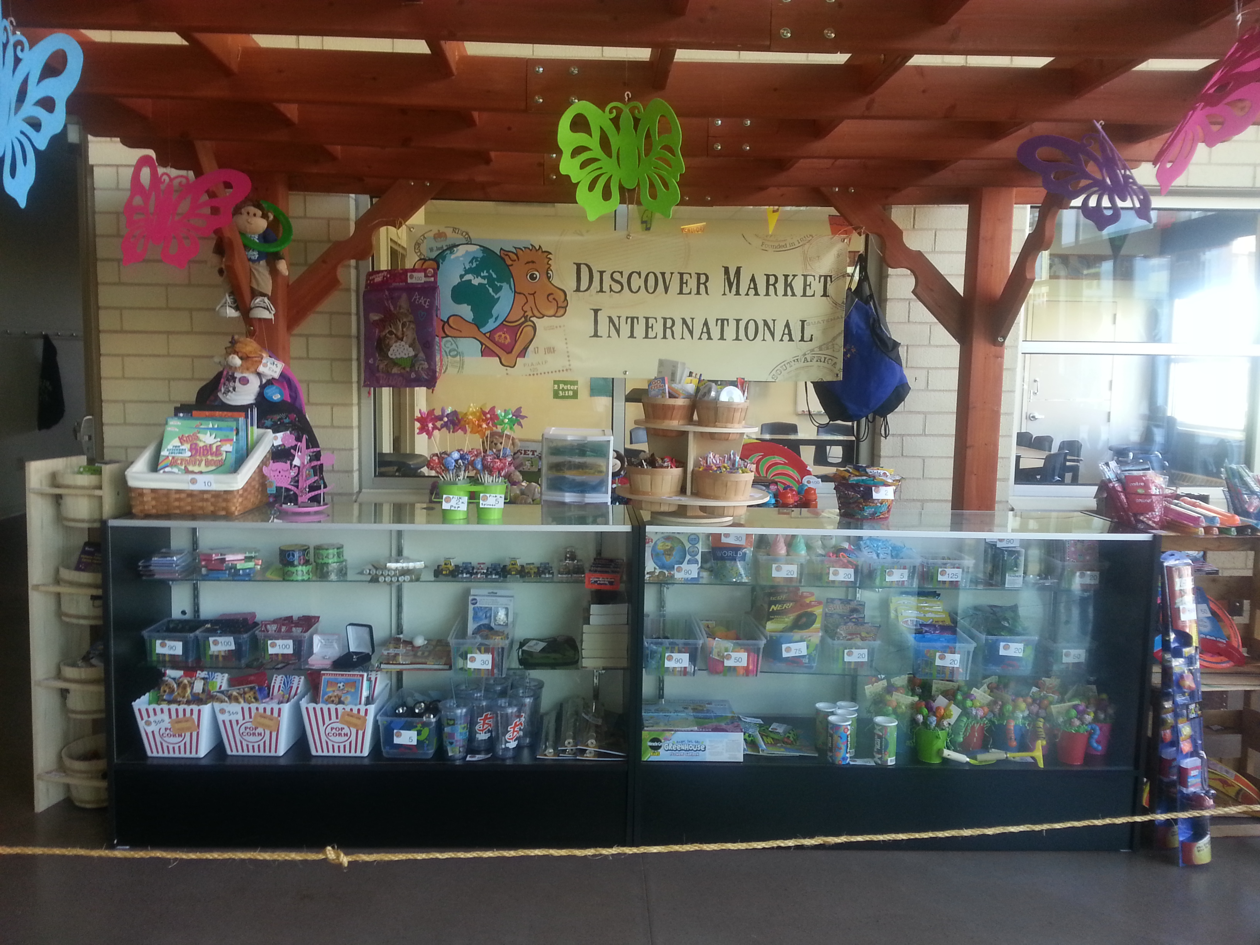
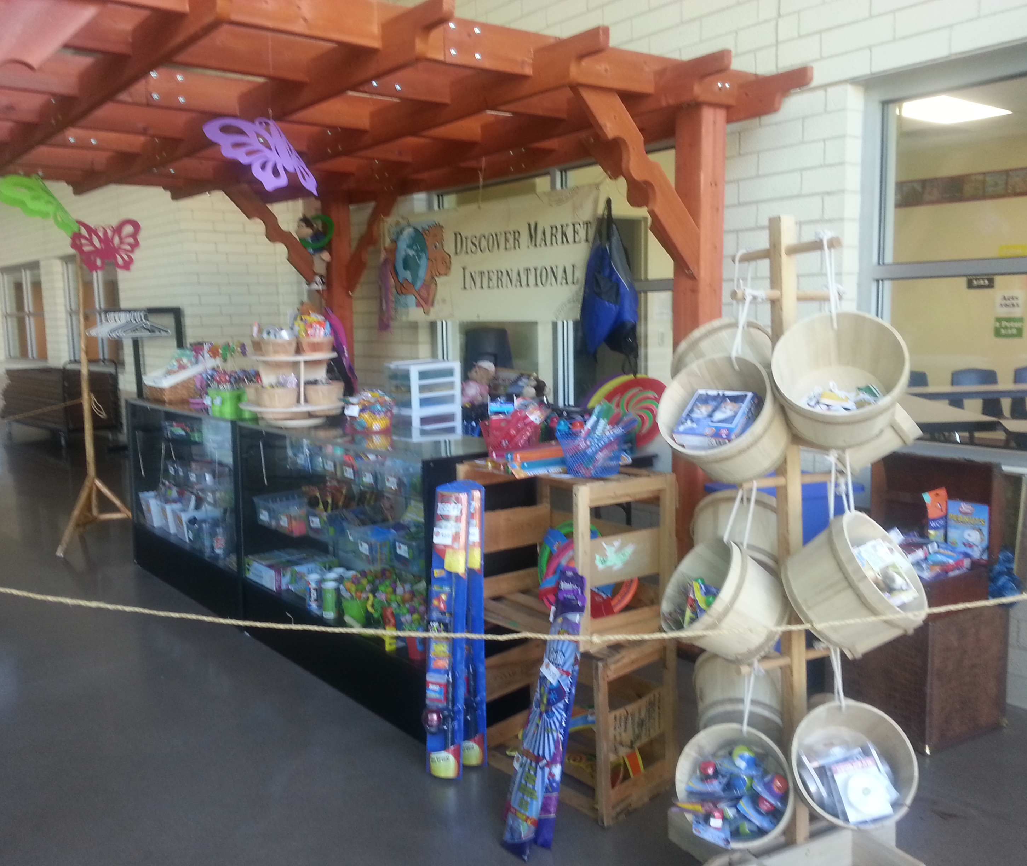
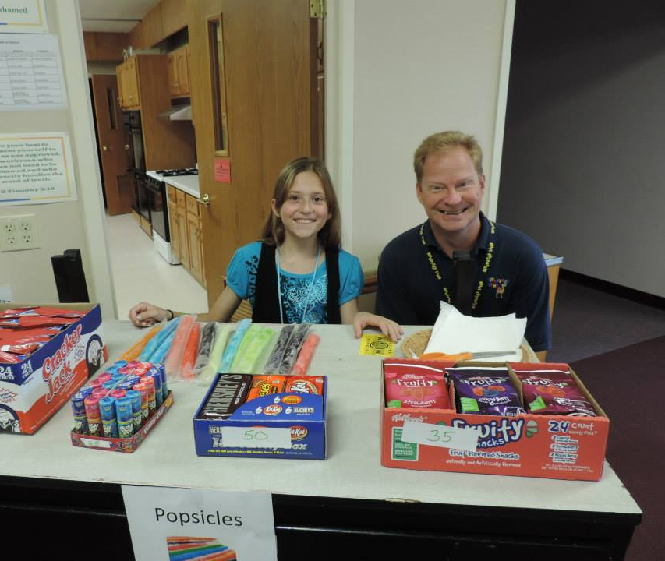
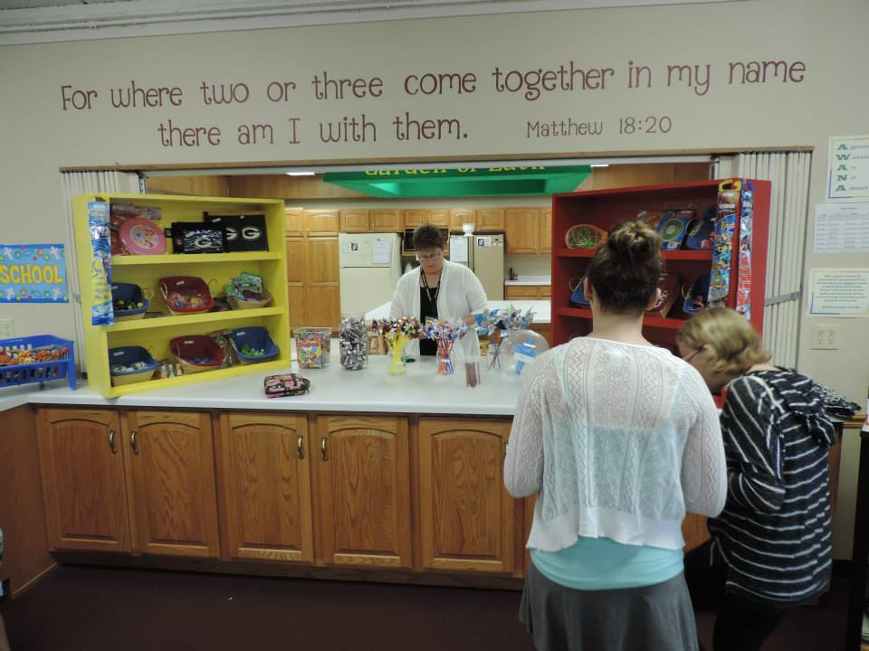
Discover Market

Slide 34
Tracker Tickets & Discover Market
FAQ
Where do the kids keep them?
What if I don’t want my kids buying stuff?
What if I'm unsure about the idea of incentives?
Do I have to print the tickets in color?

Slide 35
Tracker Tickets & Discover Market
FAQ
What do I put in the market?
How often is the market open?
Who staffs it?

Slide 36
Online Basic Training Session #3
Preparing to Lead!

Slide 37
What we are covering
End-Of-Class Review Game
Tracker’s Treasures
Classroom Bible Lesson

Slide 38
Review - Components of the Program
Elementary (K-5)
SUGGESTED SCHEDULE
-:20 Volunteers ready and prepared to welcome students as they arrive
-:15 Pre-Service Review Game
:00 Worship
:15 Discover Time
:30 Bible Lesson
:60 End-of-Class Review Game
:65 Parents pick up students

Slide 39
Classroom Lessons:
Are teacher led
Are Bible focused
Bring the Bible to Life

Slide 40
What did you notice in the demo video?

Slide 41
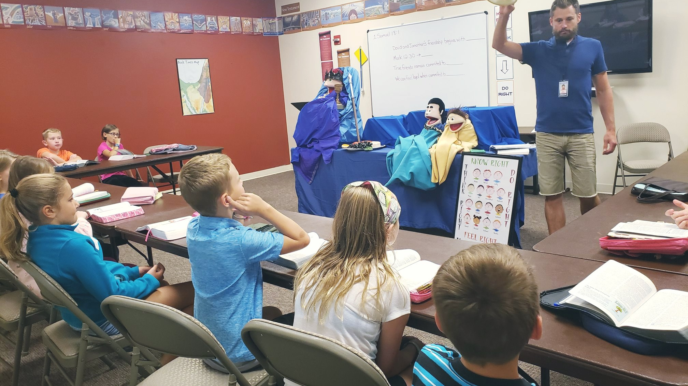
What do you notice?

Slide 42
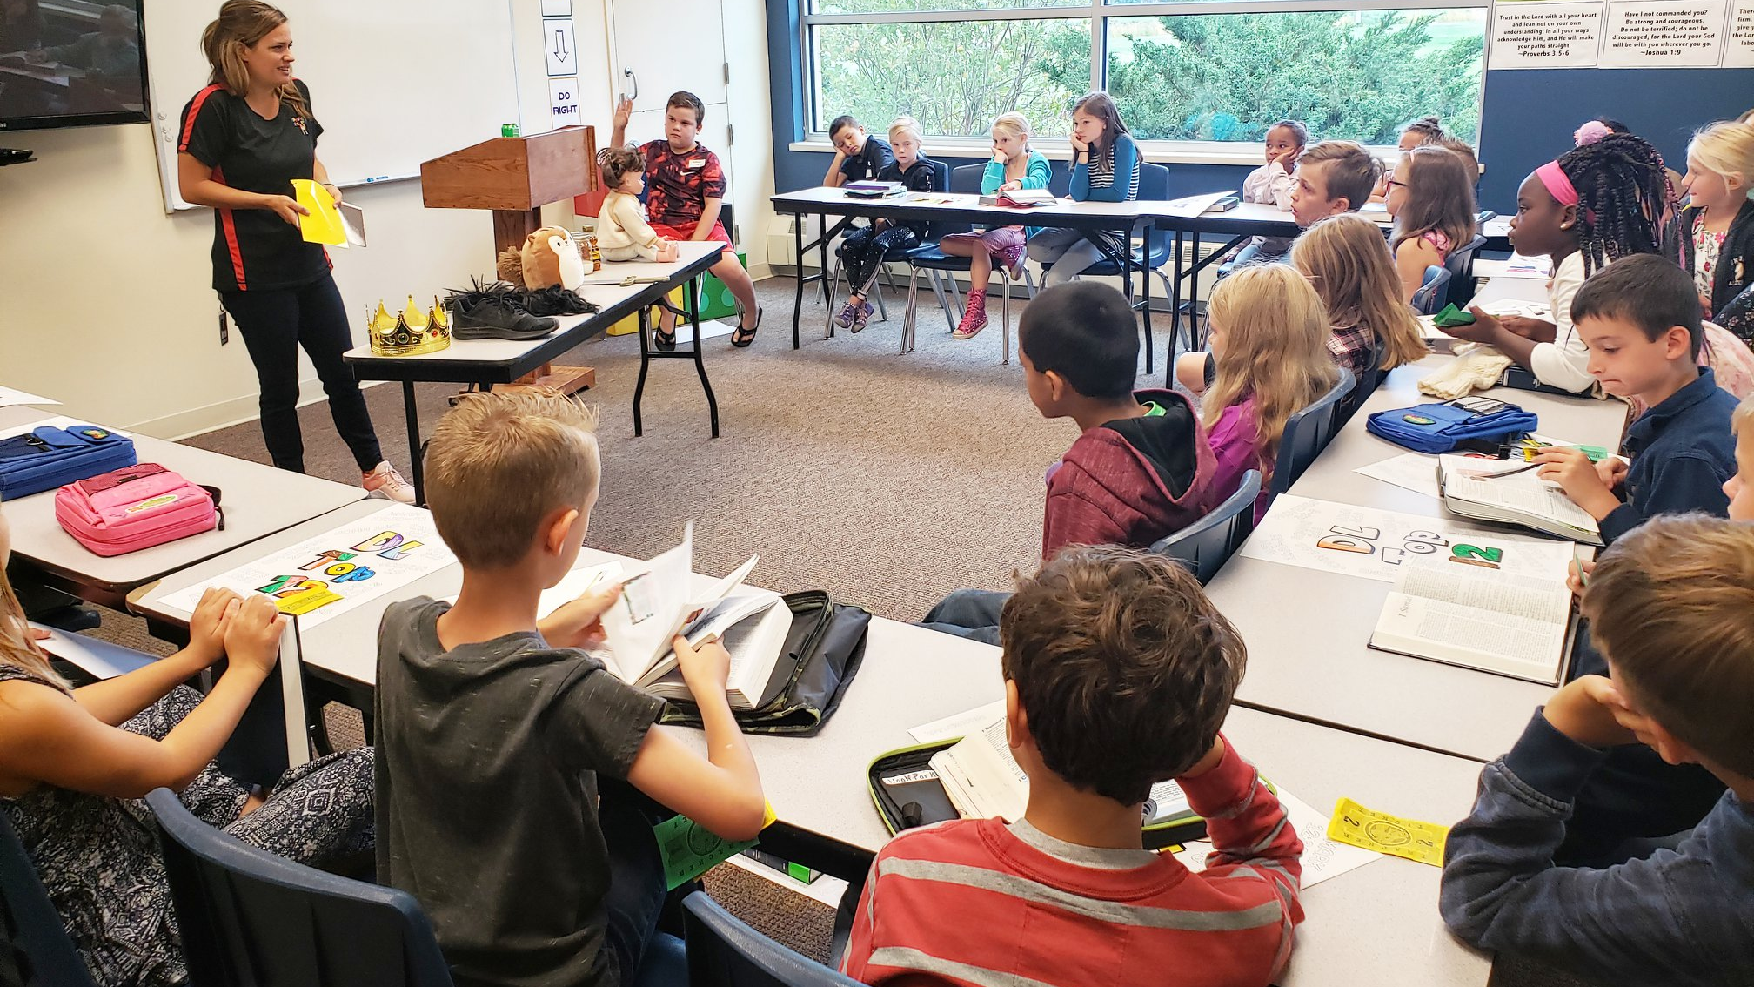
What do you notice?

Slide 43
Preparation for the Bible Lesson
Pray
Read the Scripture
Read the 4 Rights and review questions
Read the entire lesson
Study the lesson
Choose and prepare creative ideas

Slide 44

Structure of the Bible Lesson

Slide 45
Connecting the DT to the Bible Lesson
Be ready with the connection from the DT to the Bible lesson as soon as you transition back to the Bible lesson area.
Example transition from Sample Lesson 2: : Change! Today you changed (clay, Play-Doh, LEGO bricks, boxes, sand)! Do you realize that God can change people? Let’s look up 2 Corinthians 5:17 and read it. Jesus can take anyone and change their life. Today we will learn about a guy who was changed. Maybe, by the end of this lesson, you will be changed, too!
The connection is critical. If the Lead Teacher misses that point, the Discover Time activity turns into just a fun activity.

Slide 46
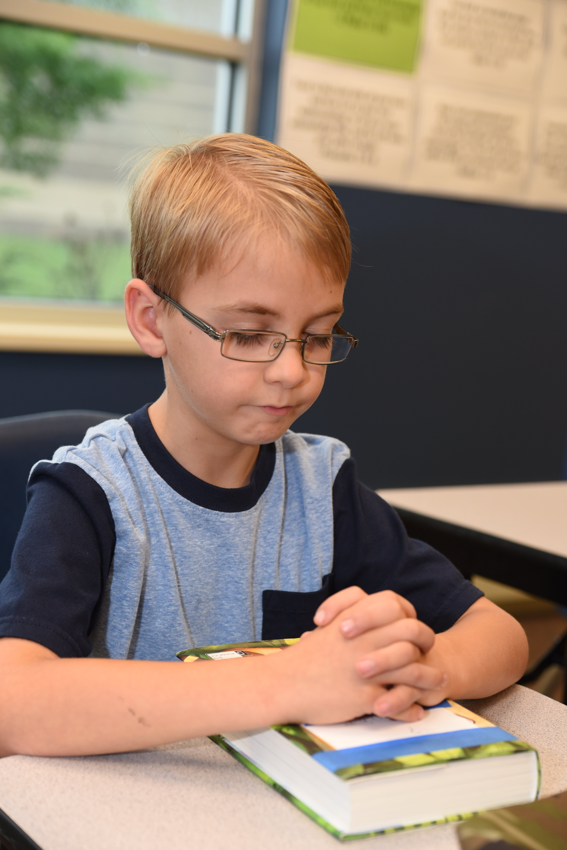
Prayer
Encourage a student to open the class in prayer. It helps them focus on God, teaches them how to pray, and encourages spiritual leadership skills.
This is also a great time to teach students concepts about prayer like:
Reverence for God – why we fold our hands and close our eyes
God hears each of us and loves it when we talk to Him
God answers prayers in three ways – Yes, No, and Wait
Prayer unites the body of Christ
Confidently praying out loud in small and large groups

Slide 47
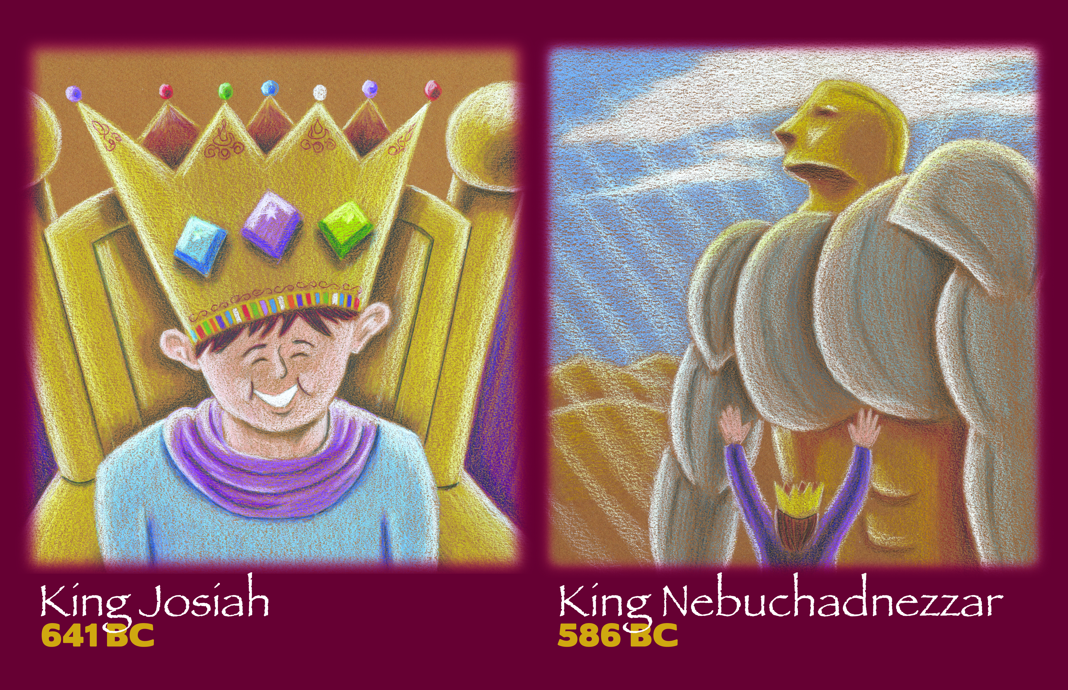
Find it
1st – Kids find it in their Bibles
Students are encouraged to bring their own Bibles.
We want kids to understand the layout of the Bible and how to use it.
2nd – We find where the lesson took place on the Bible timeline
Helps students see that God has had, and still has, a plan.
Helps students see how that lesson fits into God’s big, redemptive plan.
Helps them as we jump between the Old and New Testaments.

Slide 48
Introduce the Bible lesson
This is a few simple sentences that help grab the attention of the students. It also connects the current lesson to previous lessons.
From our sample lesson: Can you think of one person in your school or on your sports team who is really hard to like because they cheat, act arrogant, or just seem annoying? Let me introduce you to a man named Zacchaeus.

Slide 49
Scripture Outline
The outline will guide the teacher on what verses to read, which verses to summarize, and which verses to paraphrase.
It is important to bring the Bible to life in this section using props or other creative ideas!
Tip: Don’t have students read aloud!

Slide 50
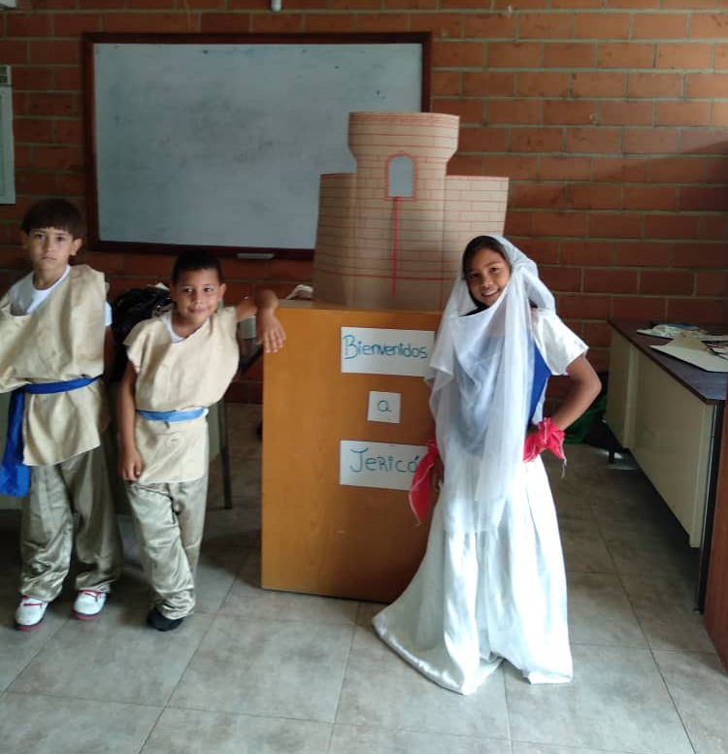
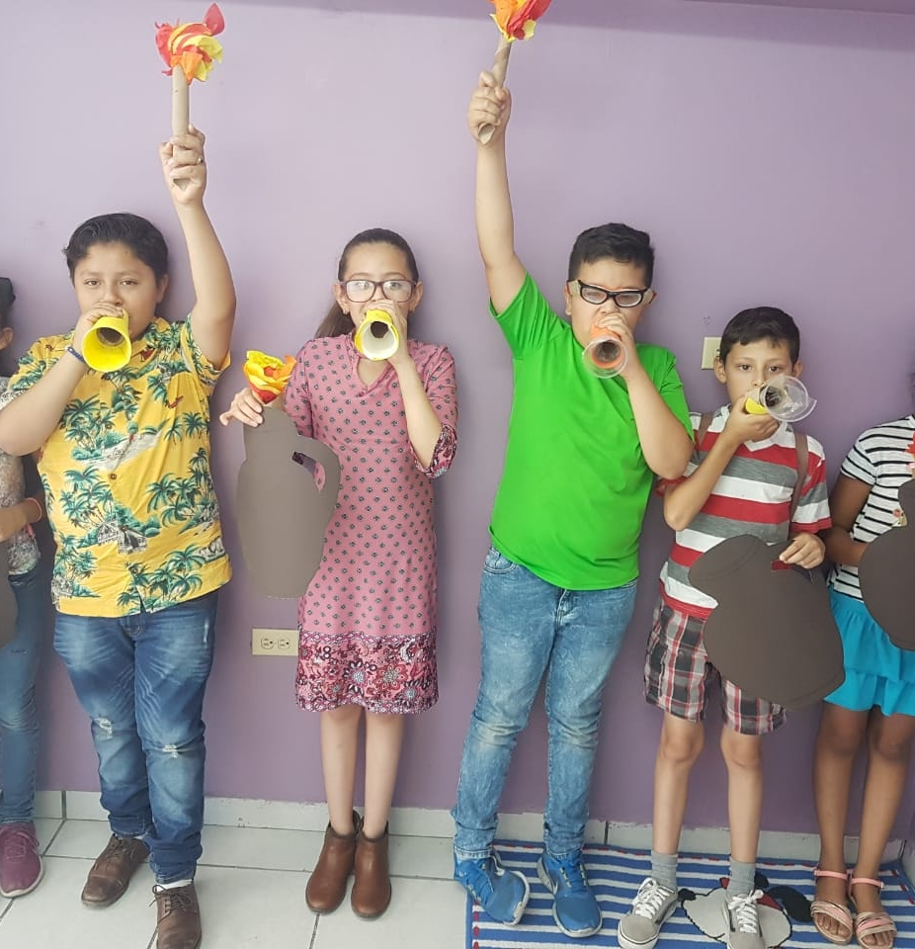

Slide 51
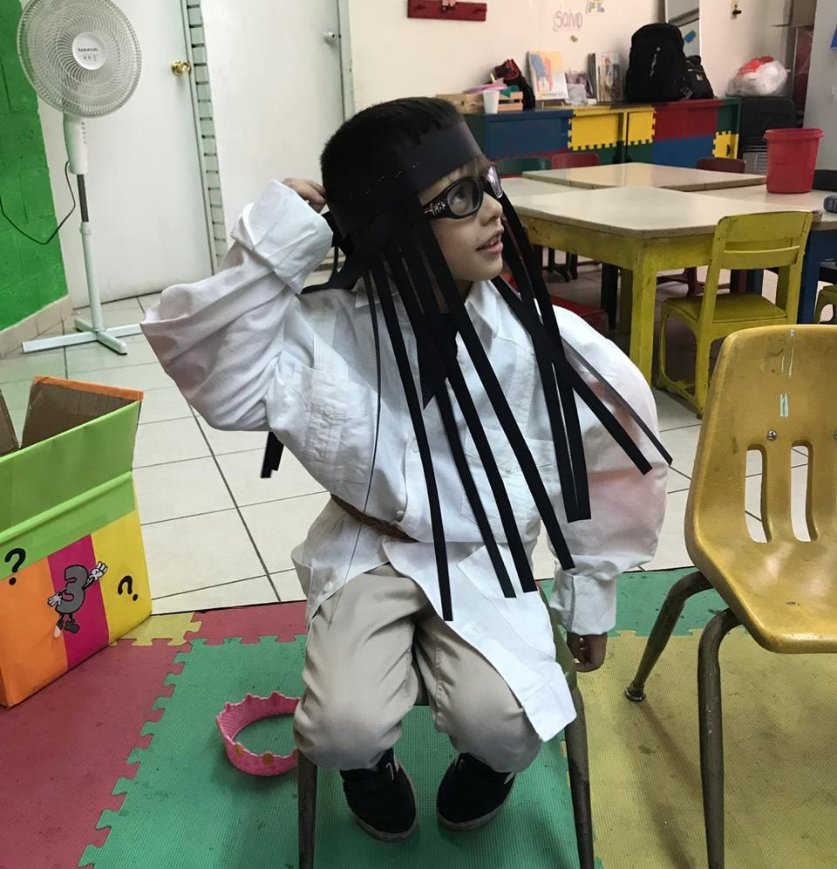
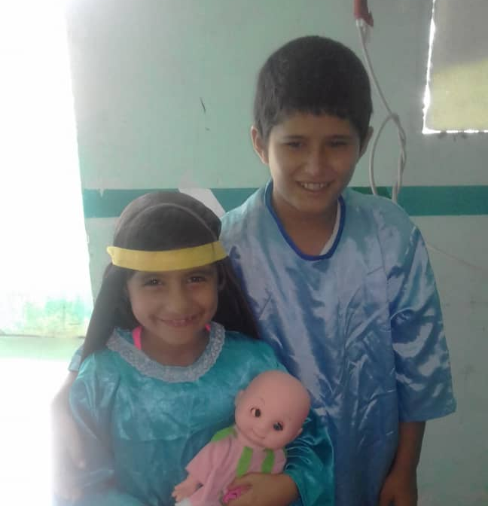

Slide 52
Conclusion
Focus students on the 4 Right Points.
Challenge students to Do Right in the real-life situations they face. Knowing your kids is where real discipleship begins!

Slide 53

Let’s look at the sample lesson

Slide 54
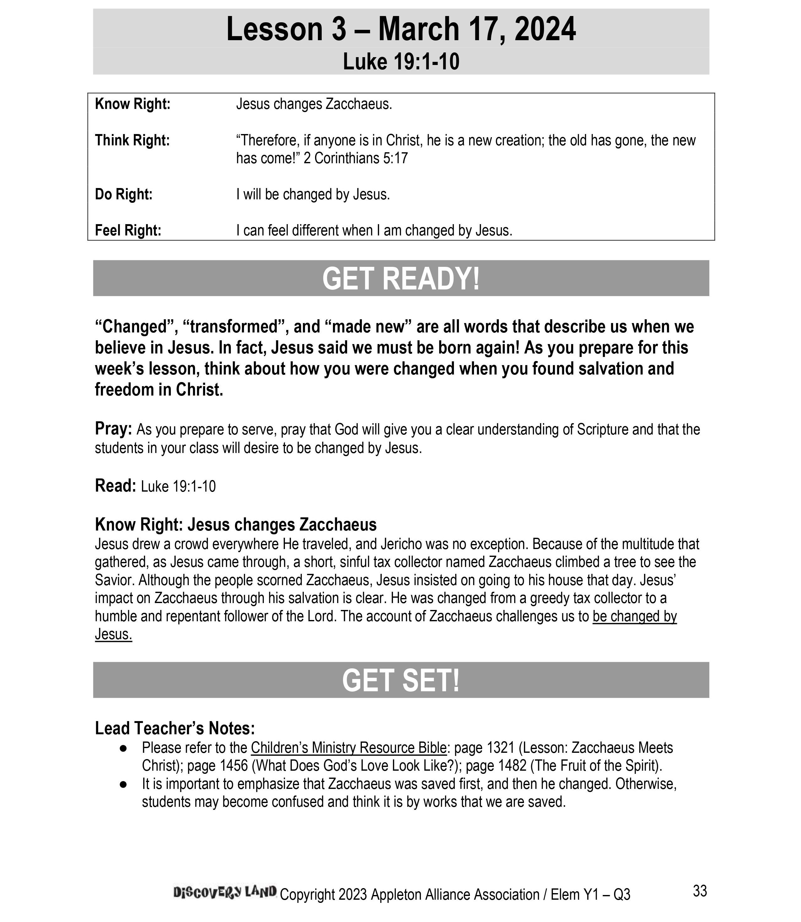
Let’s look at the sample lesson

Slide 55
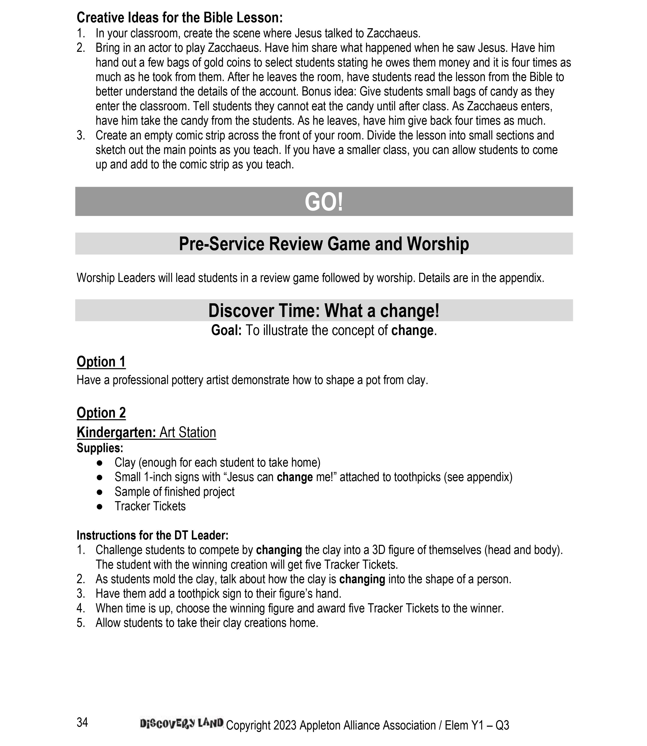
Let’s look at the sample lesson

Slide 56
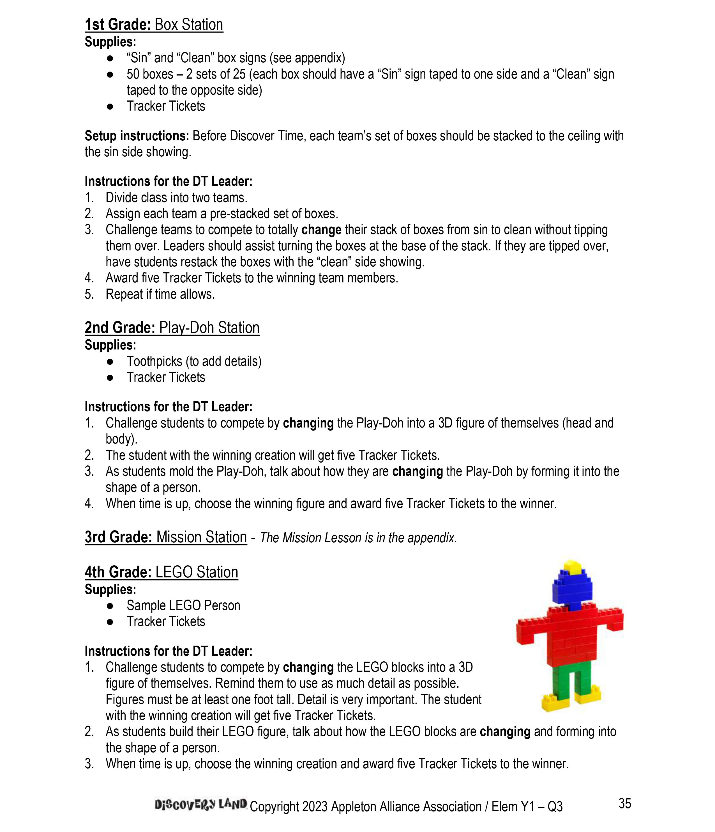

Slide 57
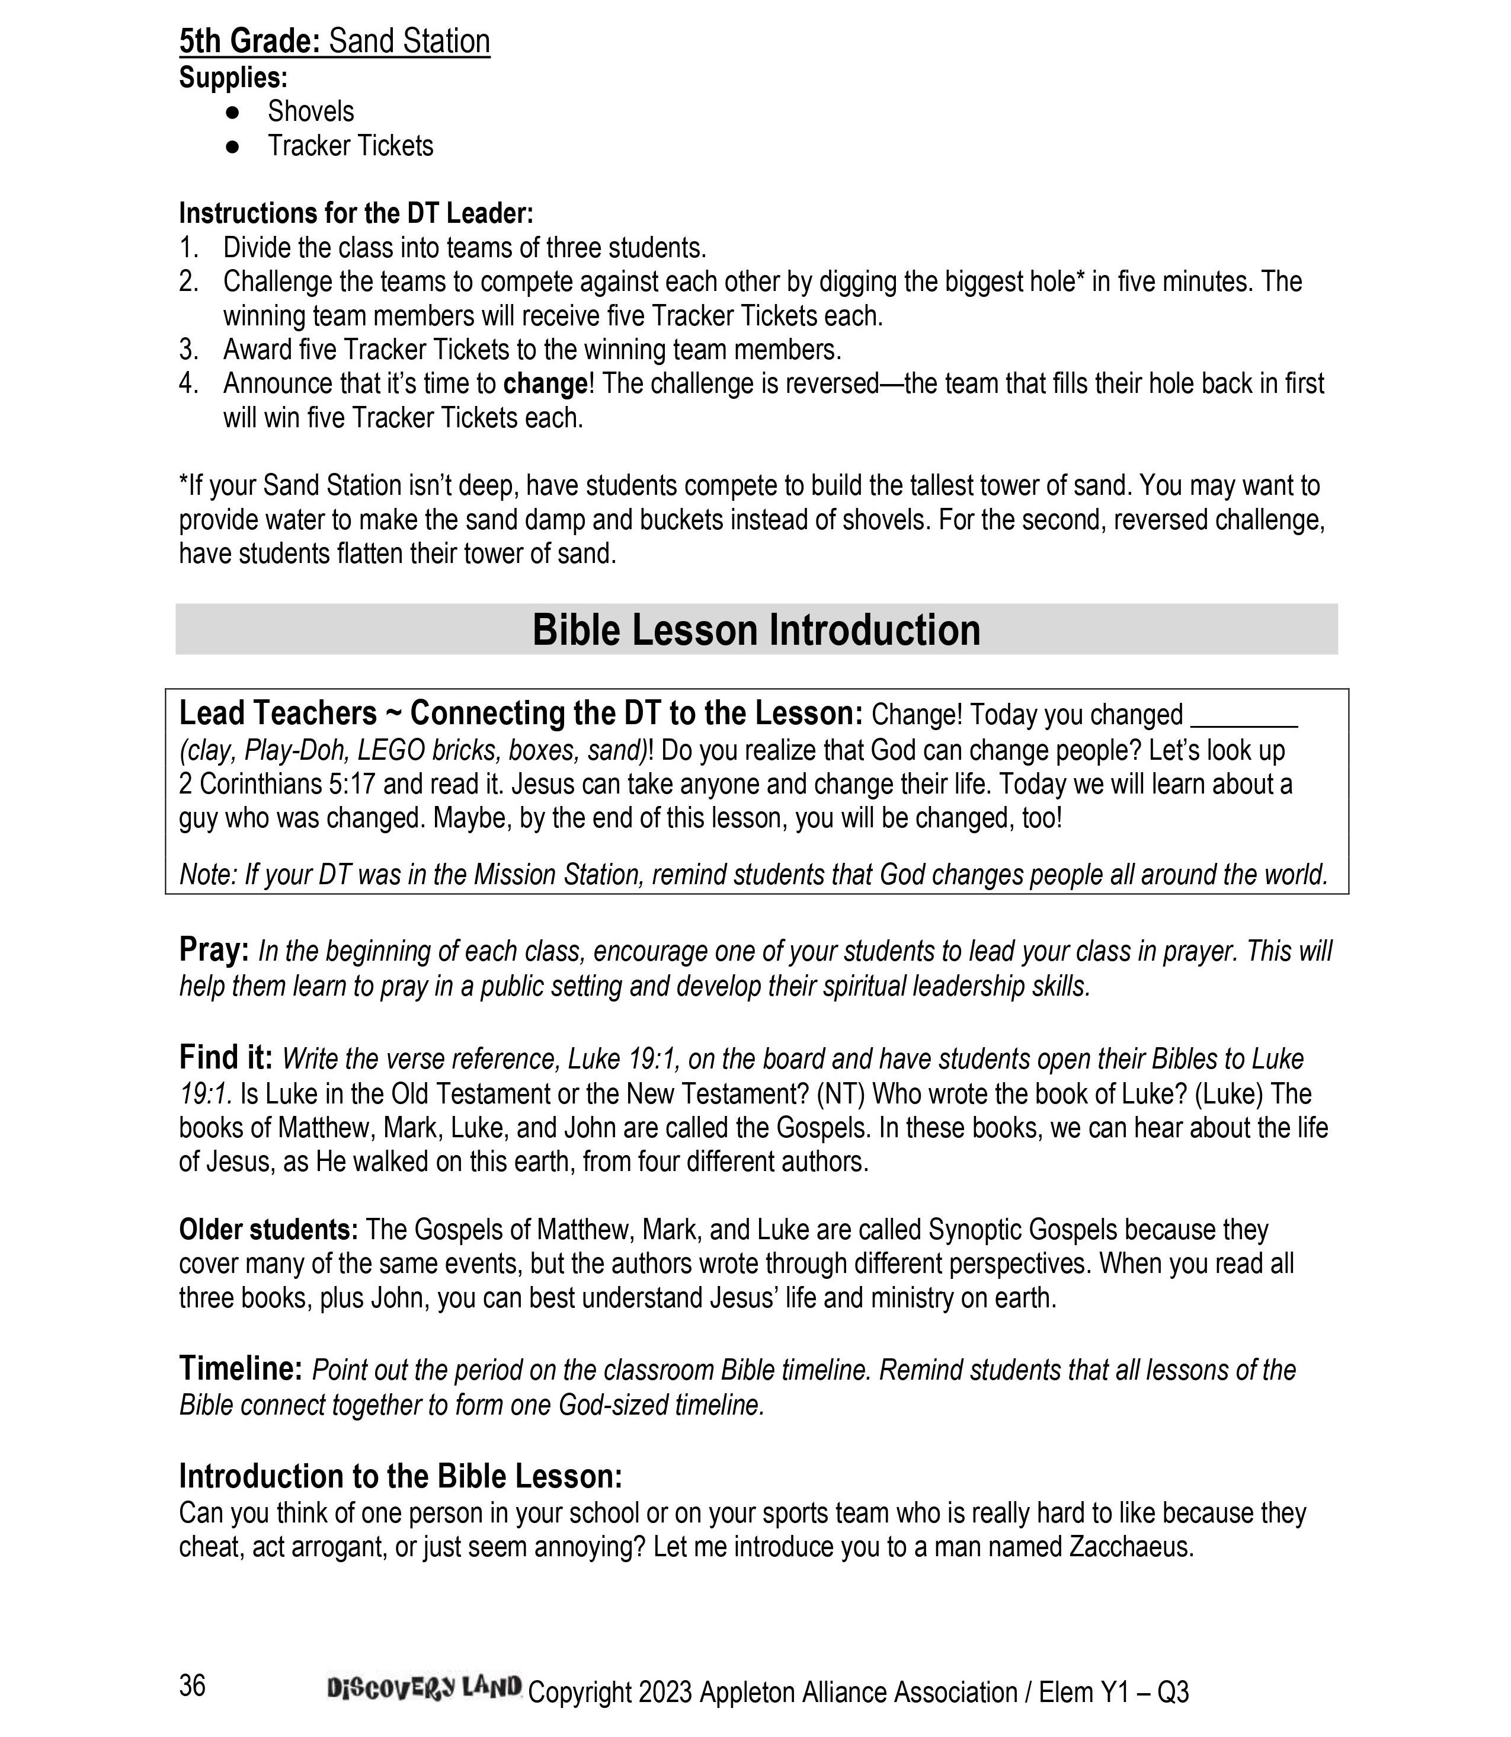

Slide 58
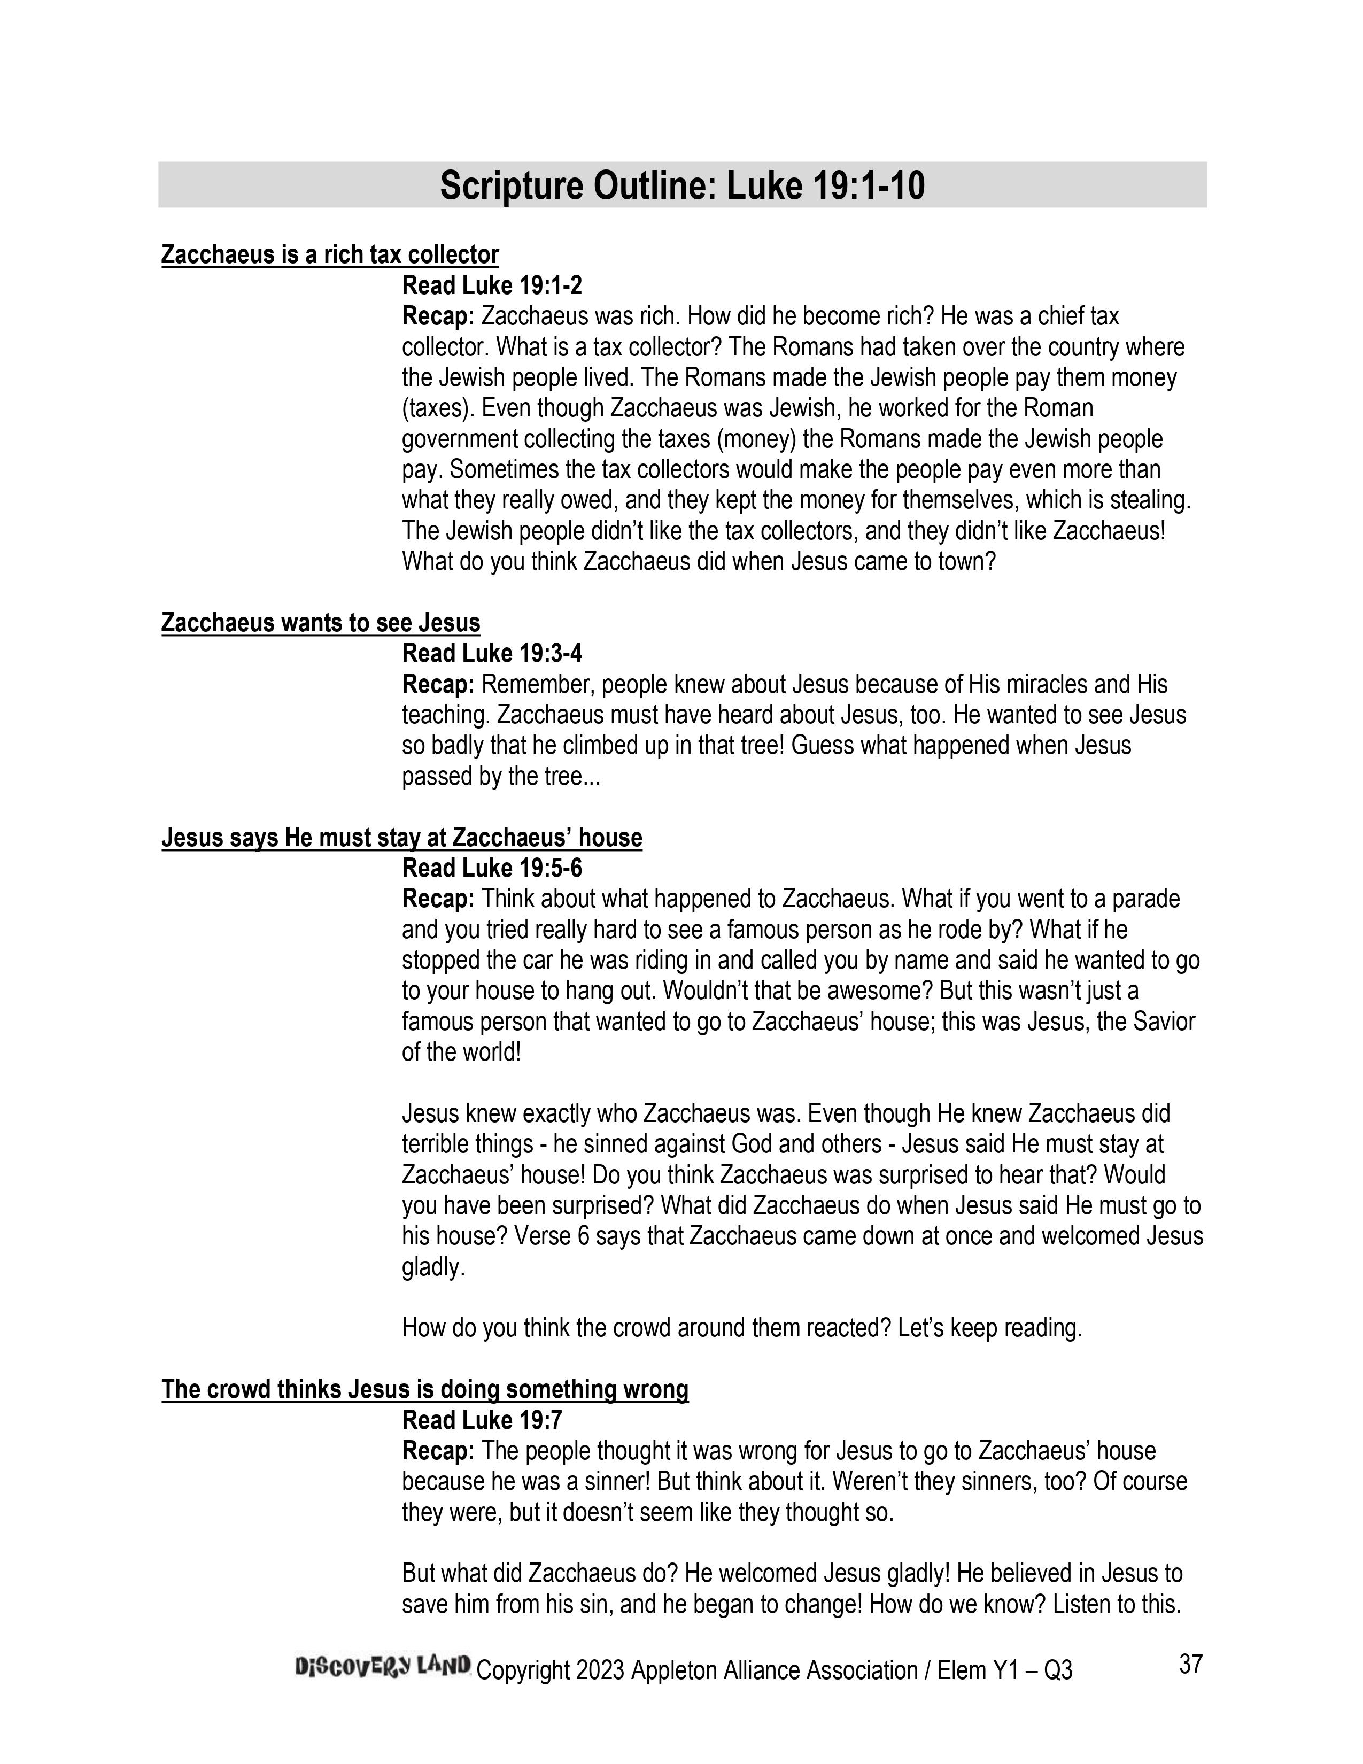

Slide 59
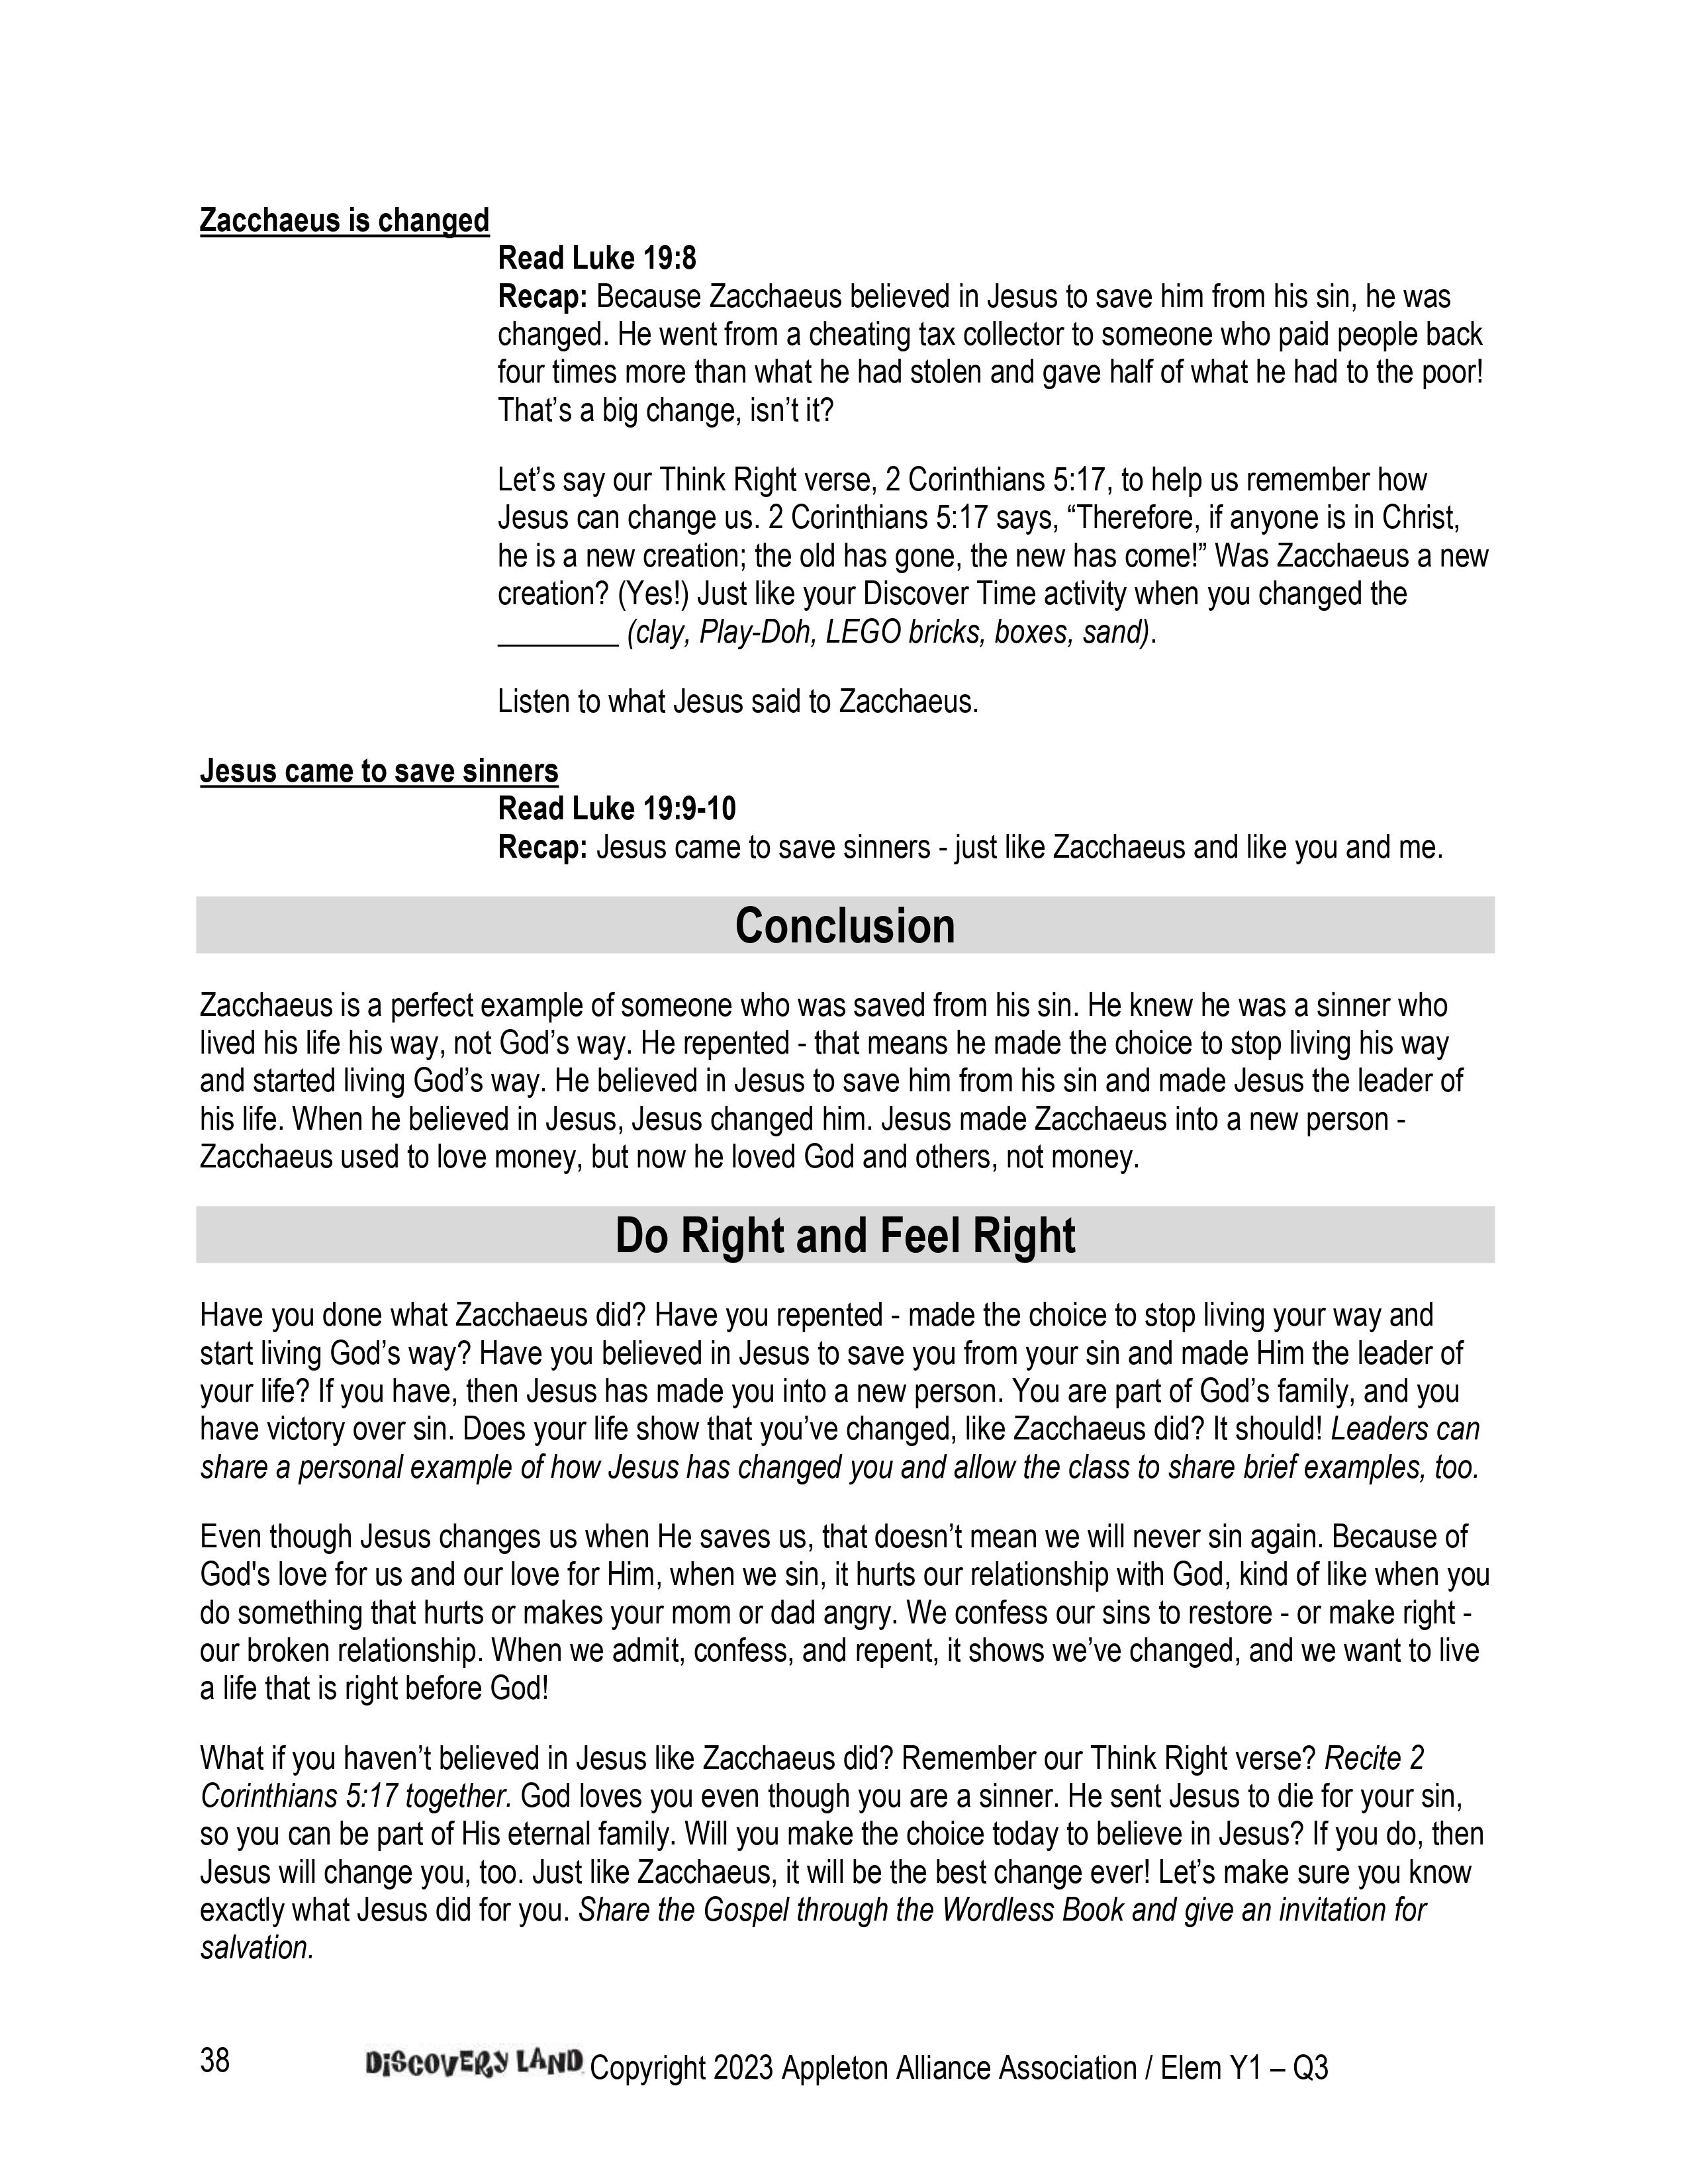

Slide 60
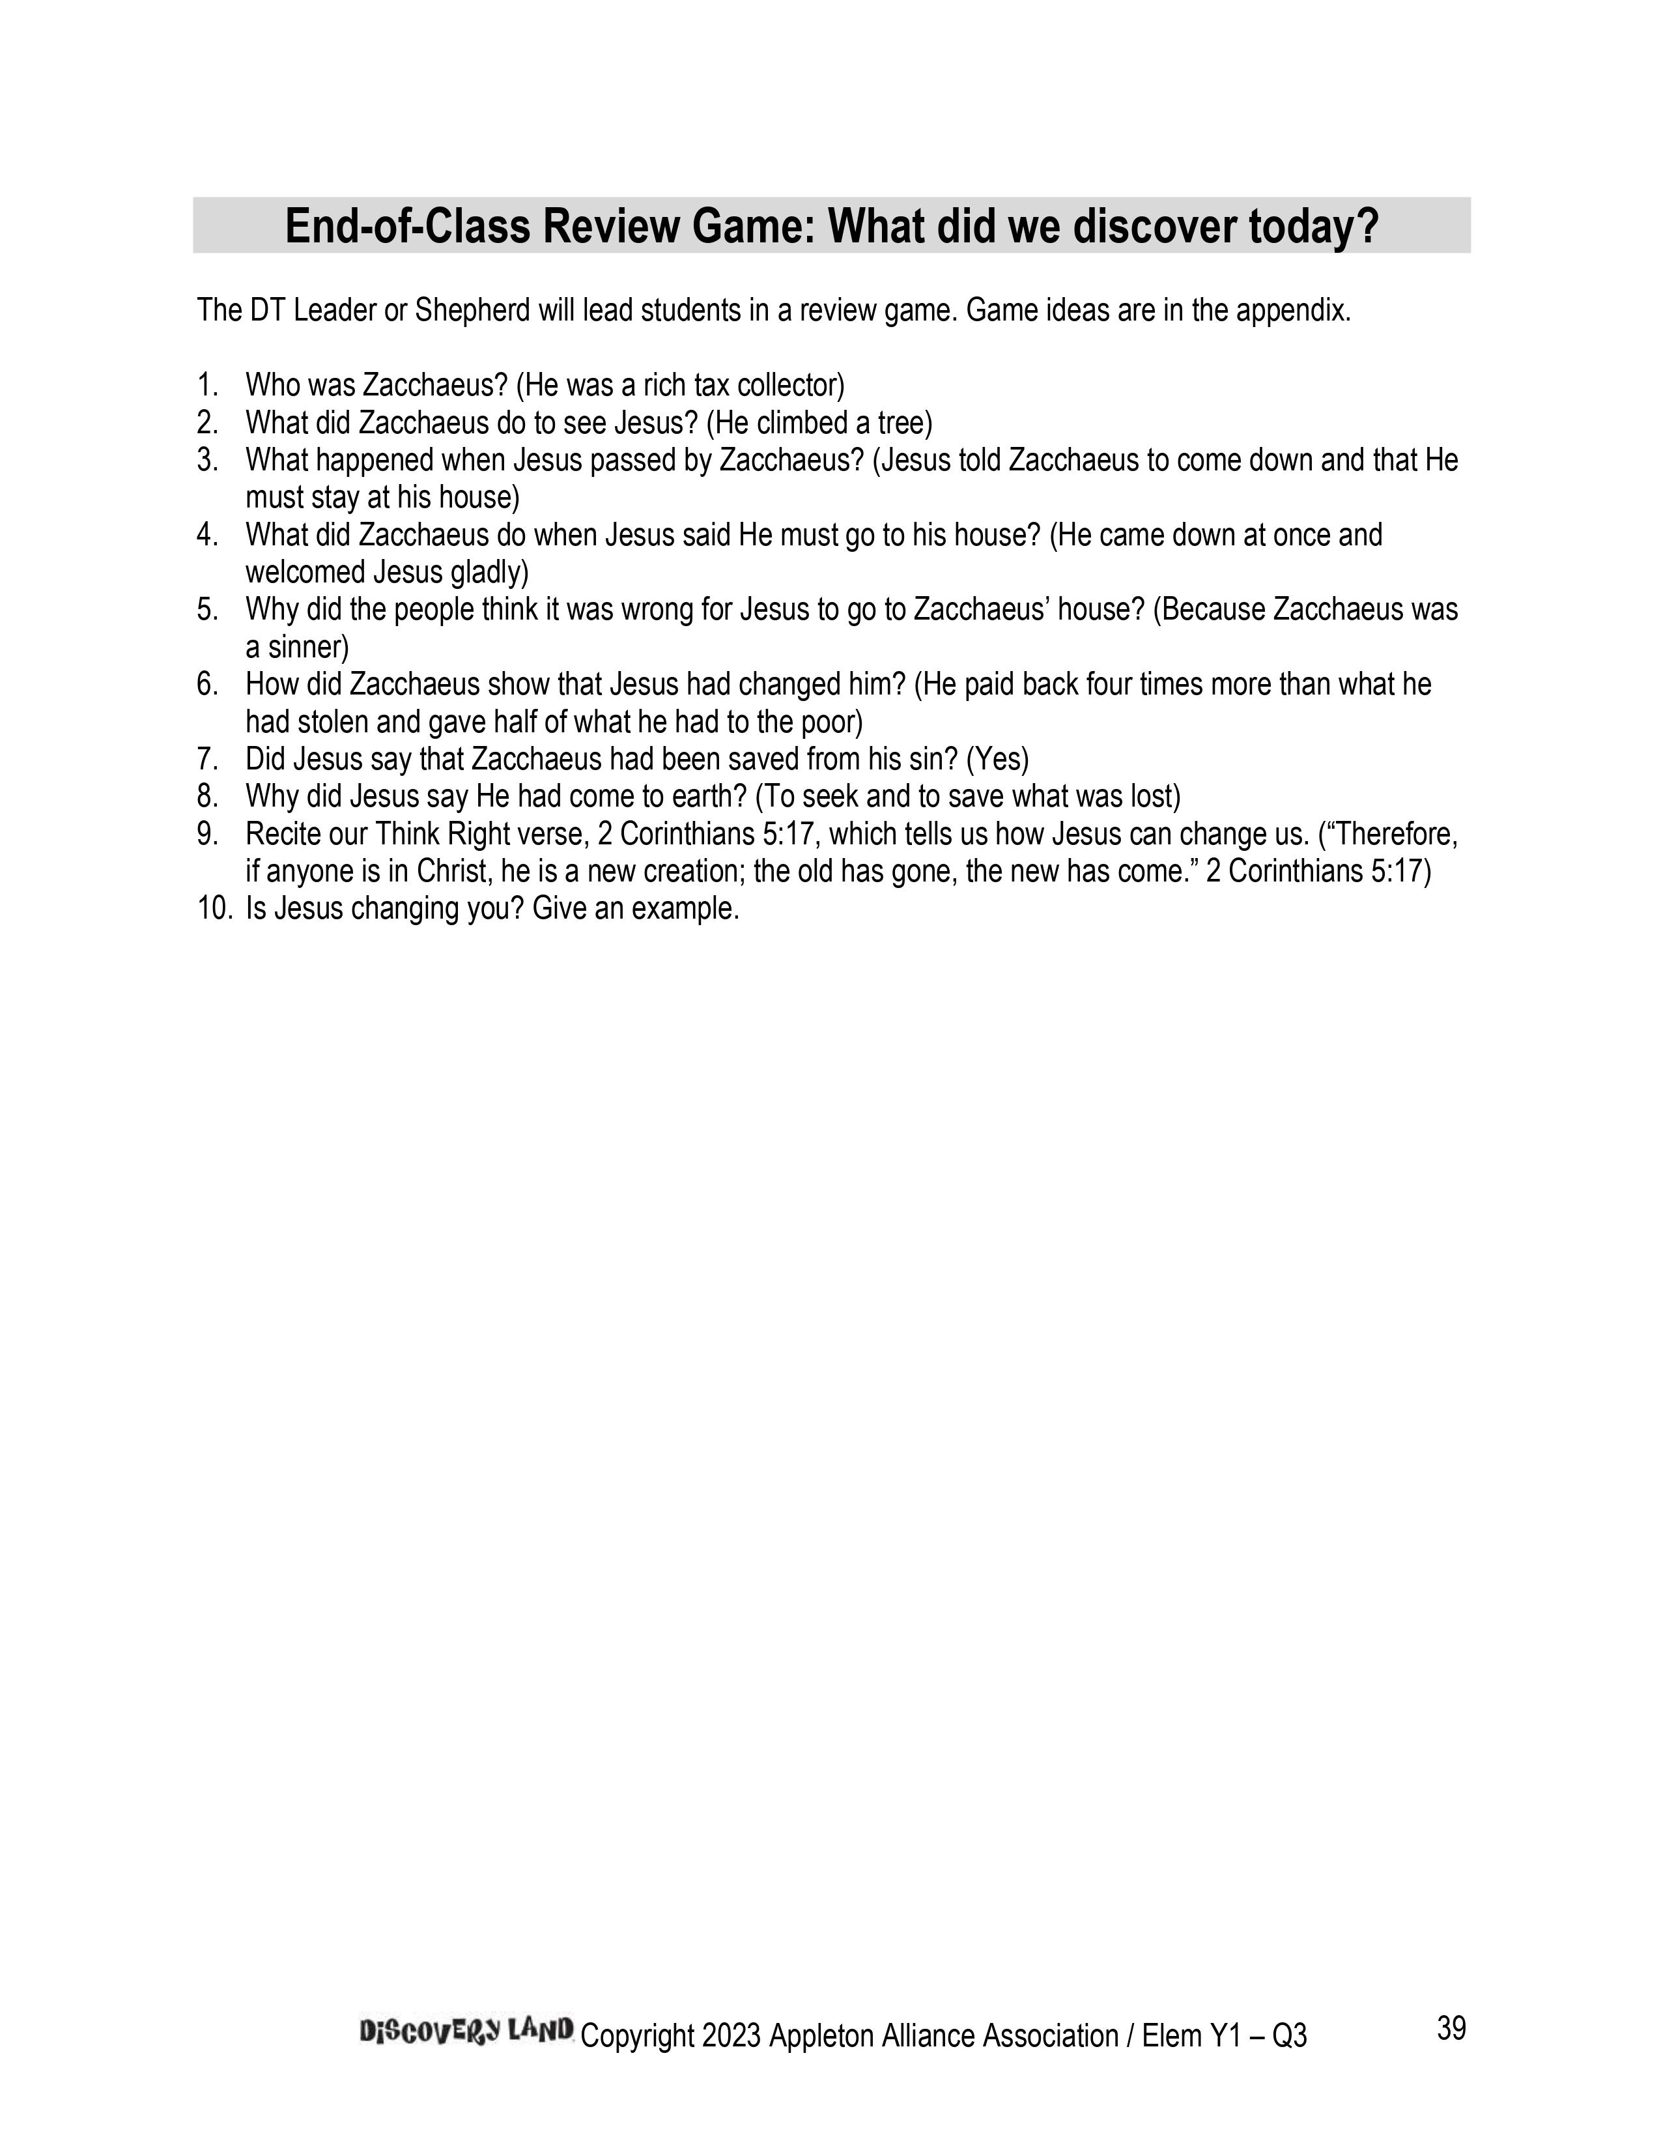

Slide 61
Classroom Resources

Slide 62
Bible Timeline
Bible Timeline

Slide 63
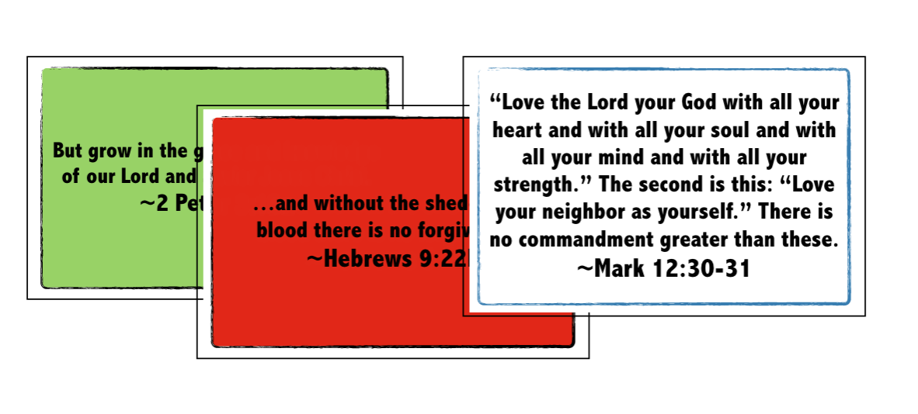
DL Top 12 Posters
Top 12
Posters

Slide 64
Books of the Bible Posters
Books of the Bible Posters

Slide 65

Feel Right Poster
Feel Right Poster

Slide 66
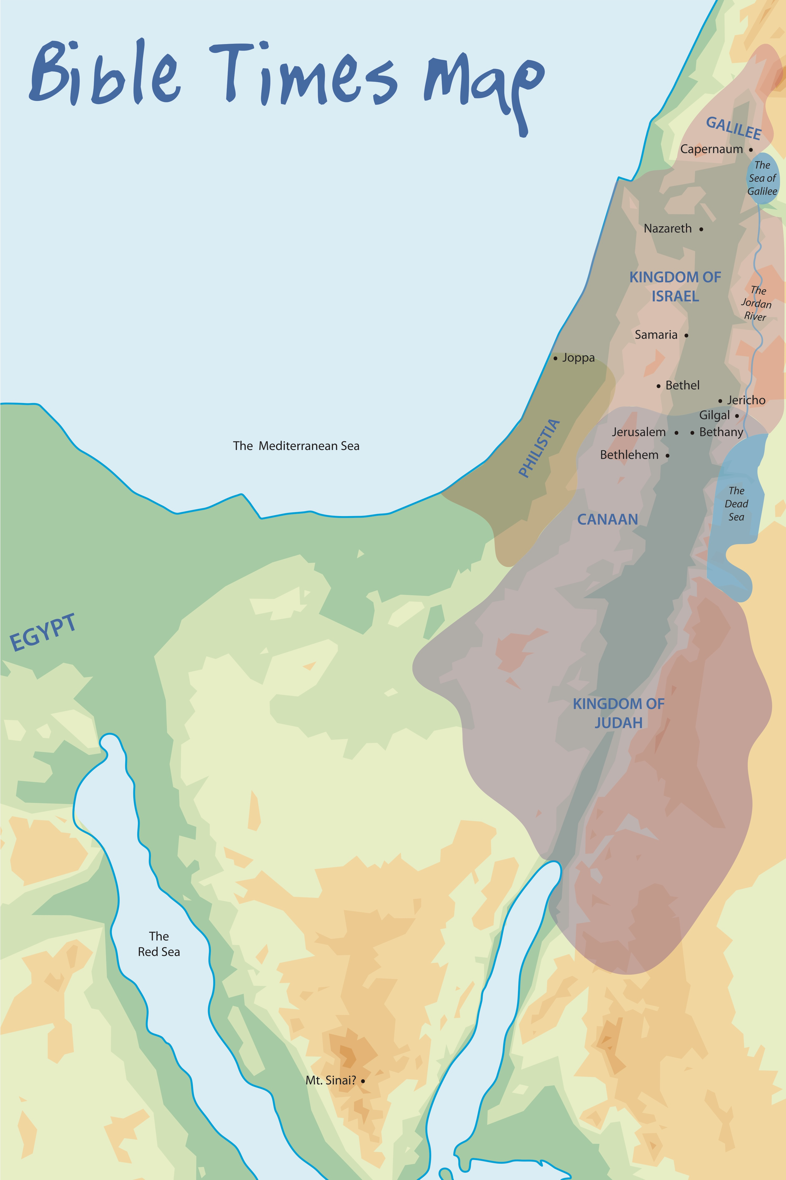
Bible Times Map
Bible Times
Map

Slide 67

End-of-class Review Games
A simple review game to play as students are being picked up by parents (much simpler than pre-service review game).
Game ideas are provided in the appendix of the curriculum.
DT Leaders or Shepherds can lead it.
Teacher can connect with the parents and hand out the take-home paper.
Example:
Trash Can Basketball
Call on a student to answer a review question.
If he/she answers the question correctly, give the student a scrap piece of paper which they will shoot into a trash can.
Award the student two Tracker Tickets if the shot is successful.

Slide 68
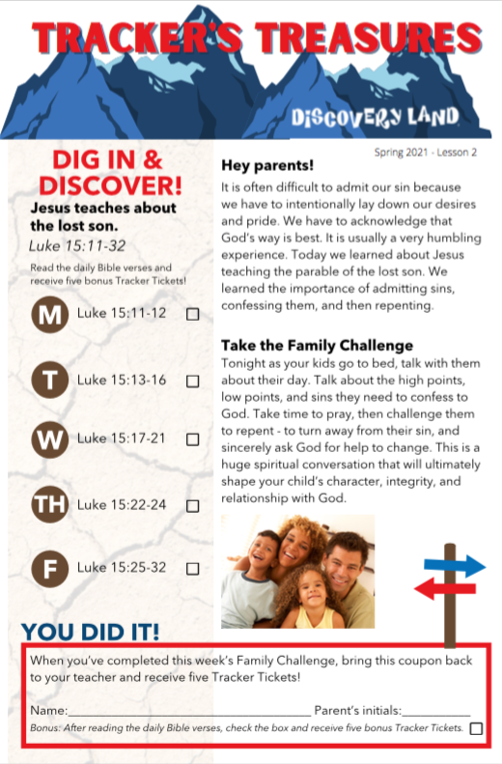
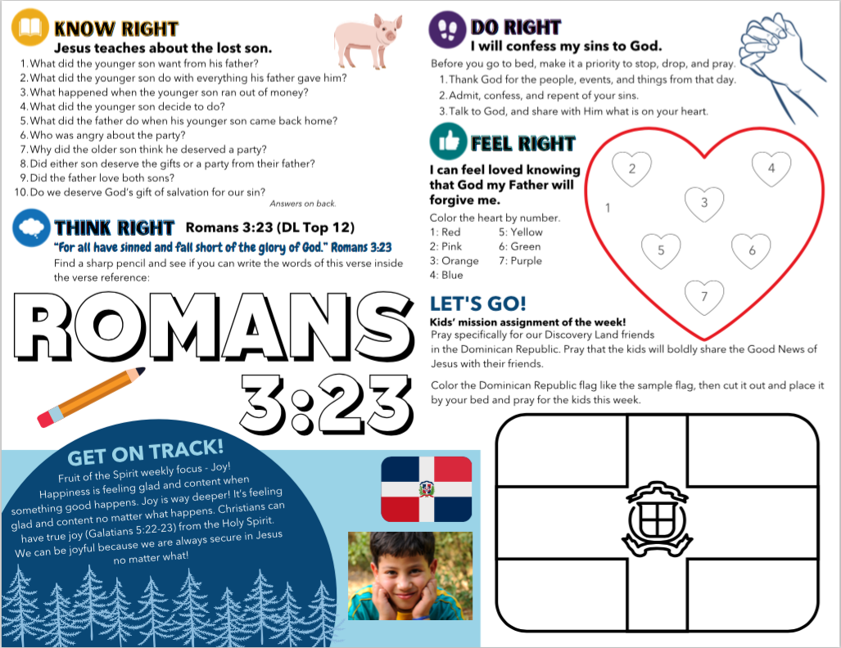

Tracker’s Treasures

Slide 69
Colorful, kid-friendly review sheets for families.
It’s an important tool that we use to partner with parents. It helps create spiritual conversations at home.
Elementary = Tracker’s Treasures
Preschool = Tracker Jr.
Includes:
  Family Challenge related to the lesson
  Daily Bible verse readings
  Review questions
  Activities for kids that connect with the week’s 4 Rights
Tracker’s Treasures

Slide 70
Teachers hand out the TT and TJr. to the parent each week and encourage them to complete it with their child.
There is a coupon to be returned for Tracker Tickets (Elem.) or a small prize (Preschool).
Issues are released quarterly (emailed and added to the member’s area of the website).
Issues are available as a pdf or customizable with the Pro version of Canva.com.
Tracker’s Treasures

Slide 71
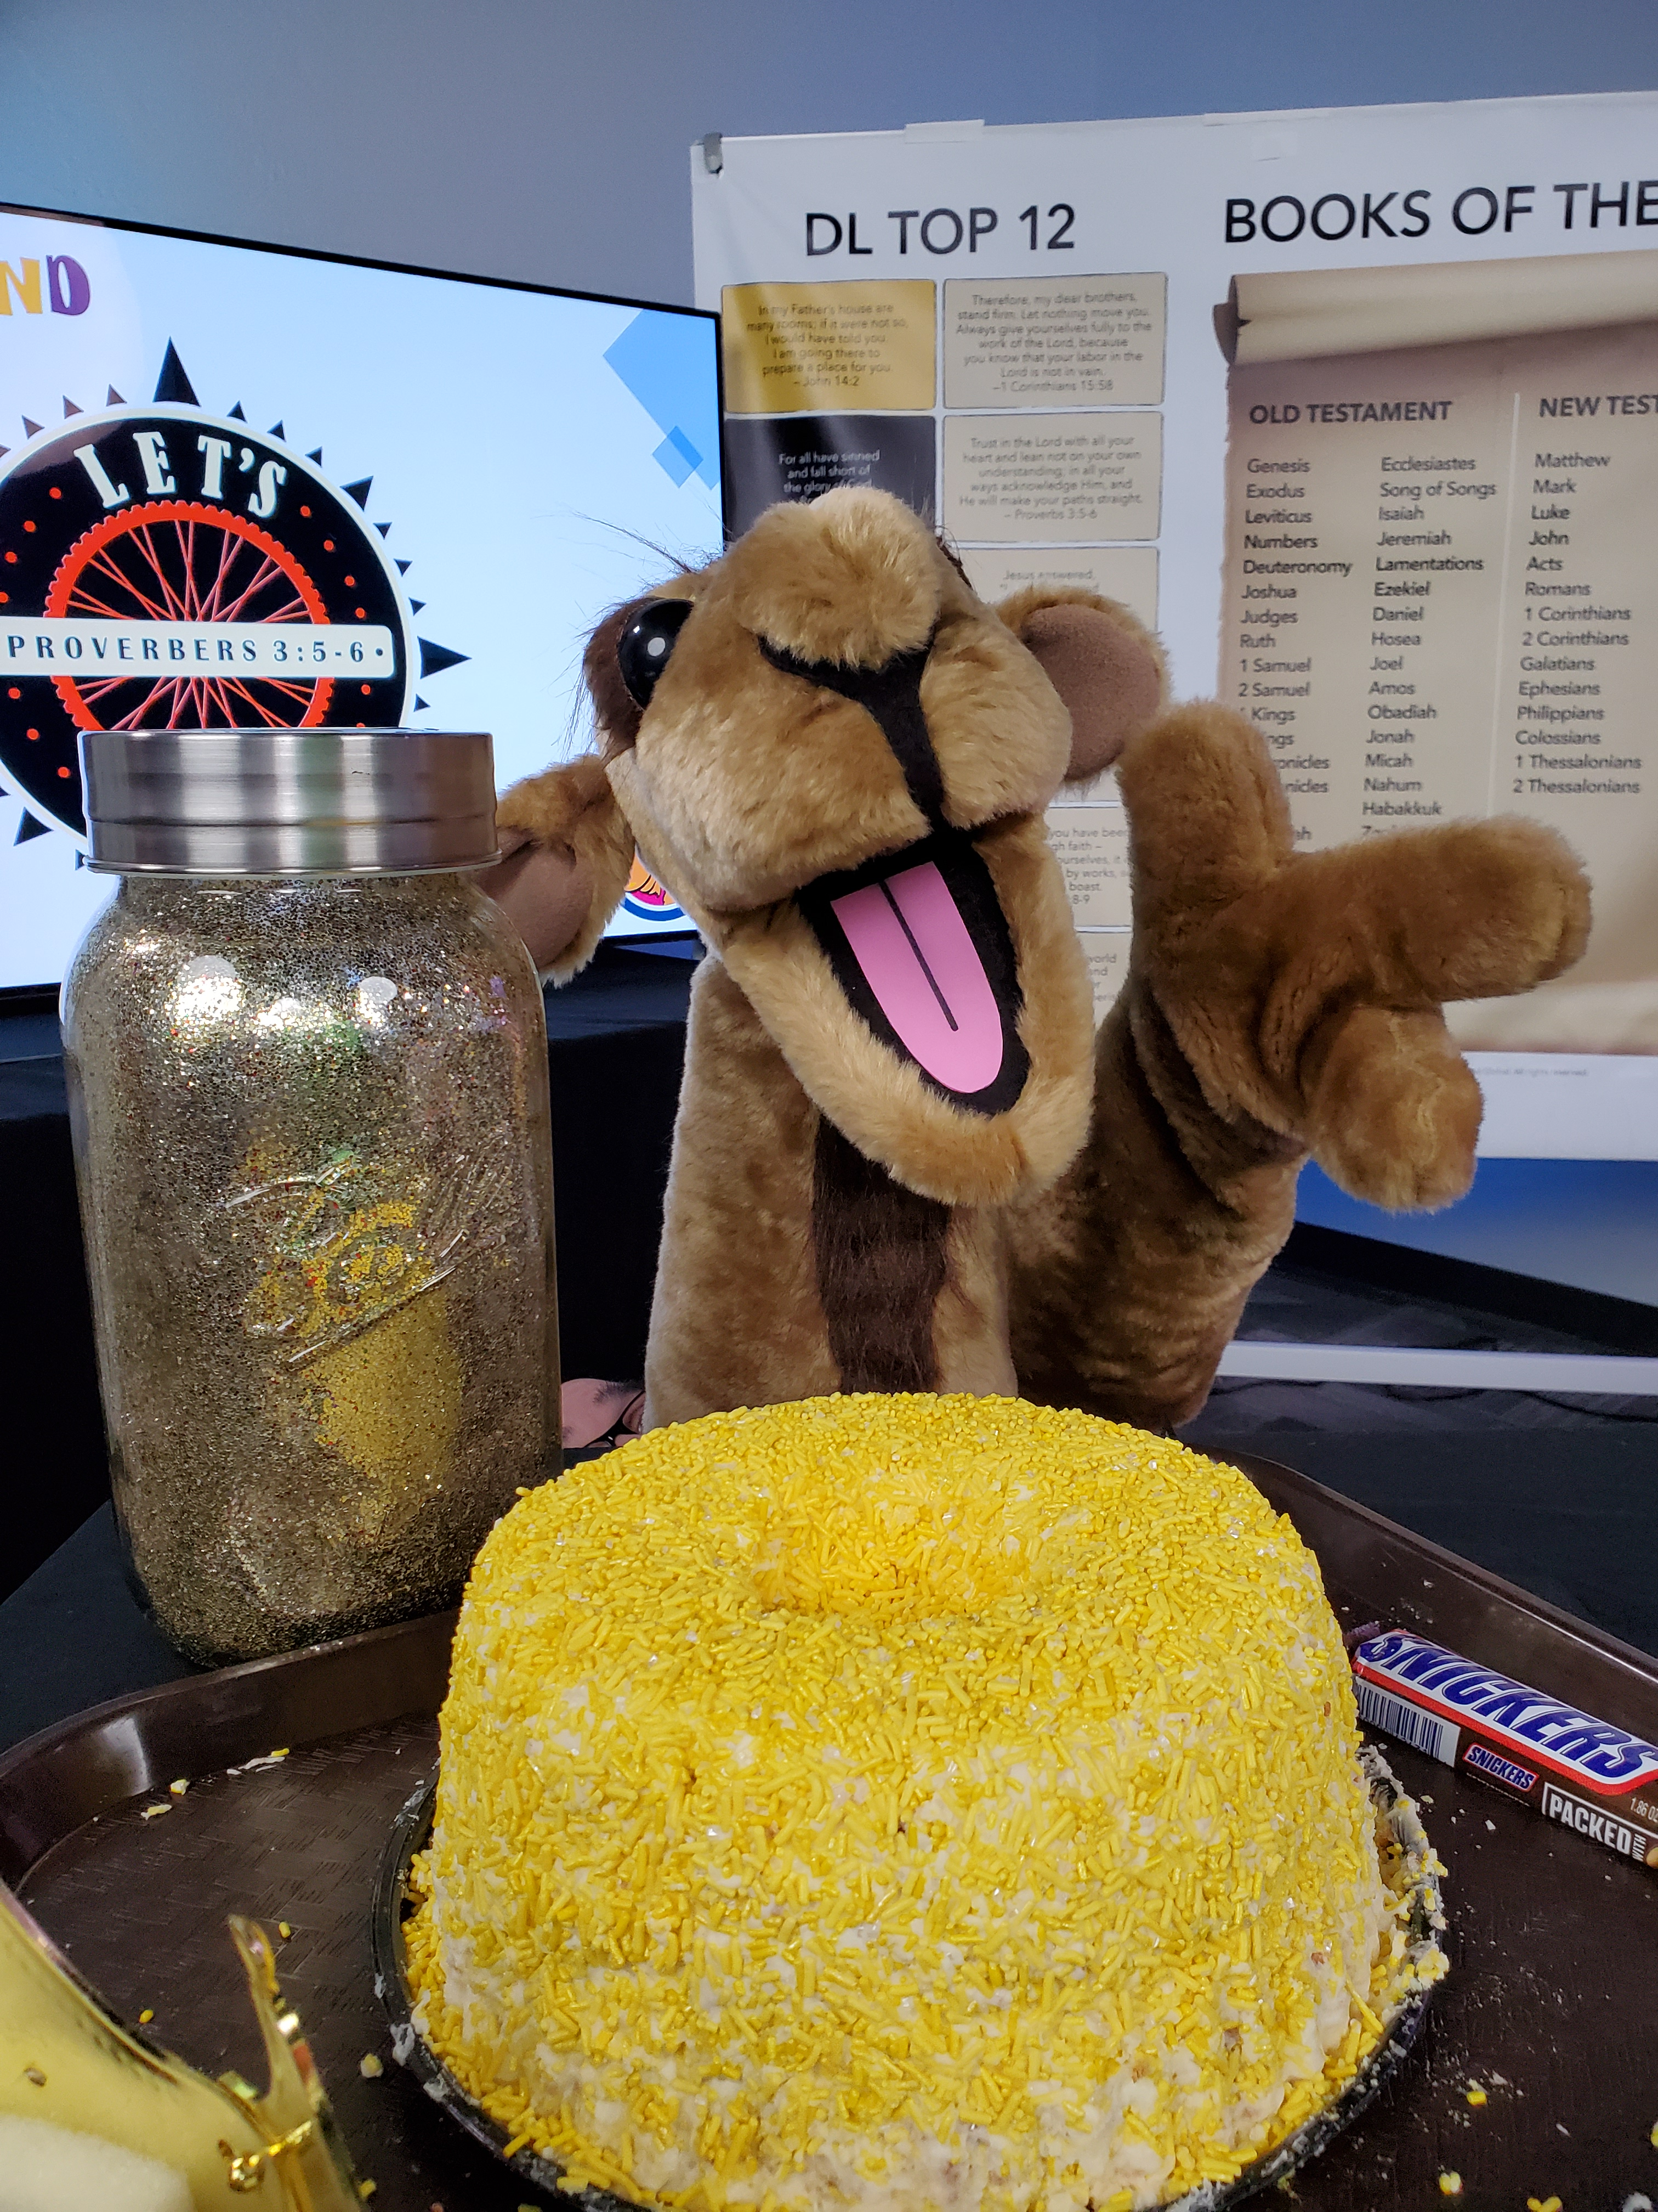
Introducing…Tracker!

Slide 72

Discover Time
Mission Station
Takes place during 15-minute Discover Time activity.
Goals:
Educate on the Great Commission
Educate about different countries and cultures
Challenge kids to make a global impact
Encourage kids to listen for God's call to become a global missionary
*Additional resources for Alliance Kids DL members

Slide 73
Online Basic Training Session #4
Preparing to Lead!

Slide 74
What we are covering in this session
Implementation Steps
Training Leaders
Wordless Book

Slide 75
The Gospel

Slide 76




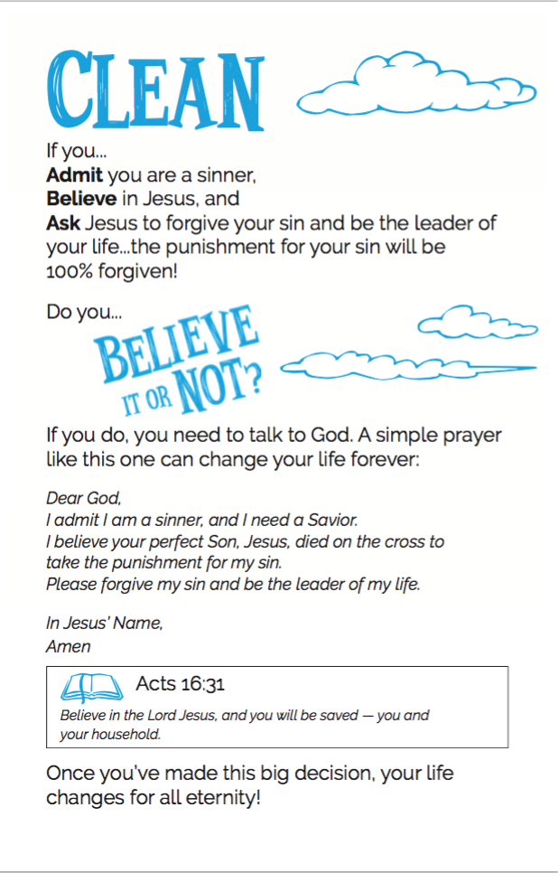

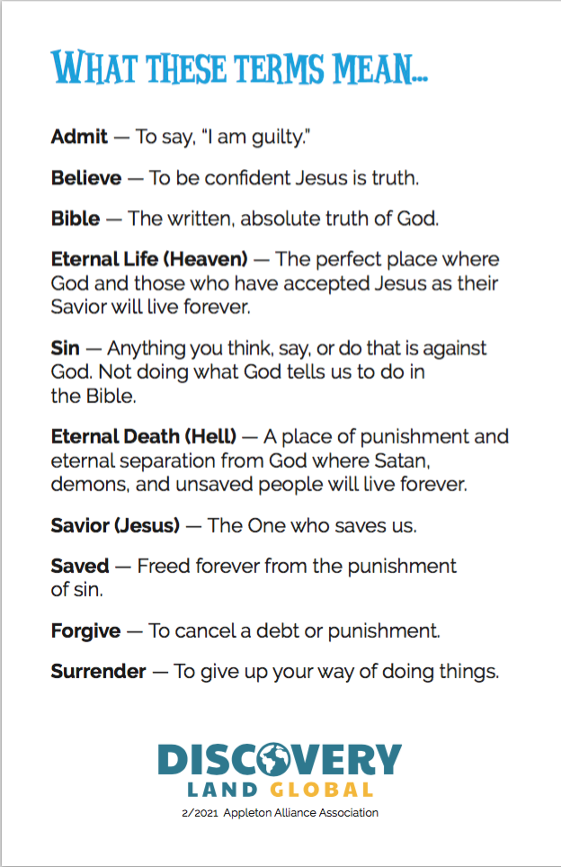

Slide 77
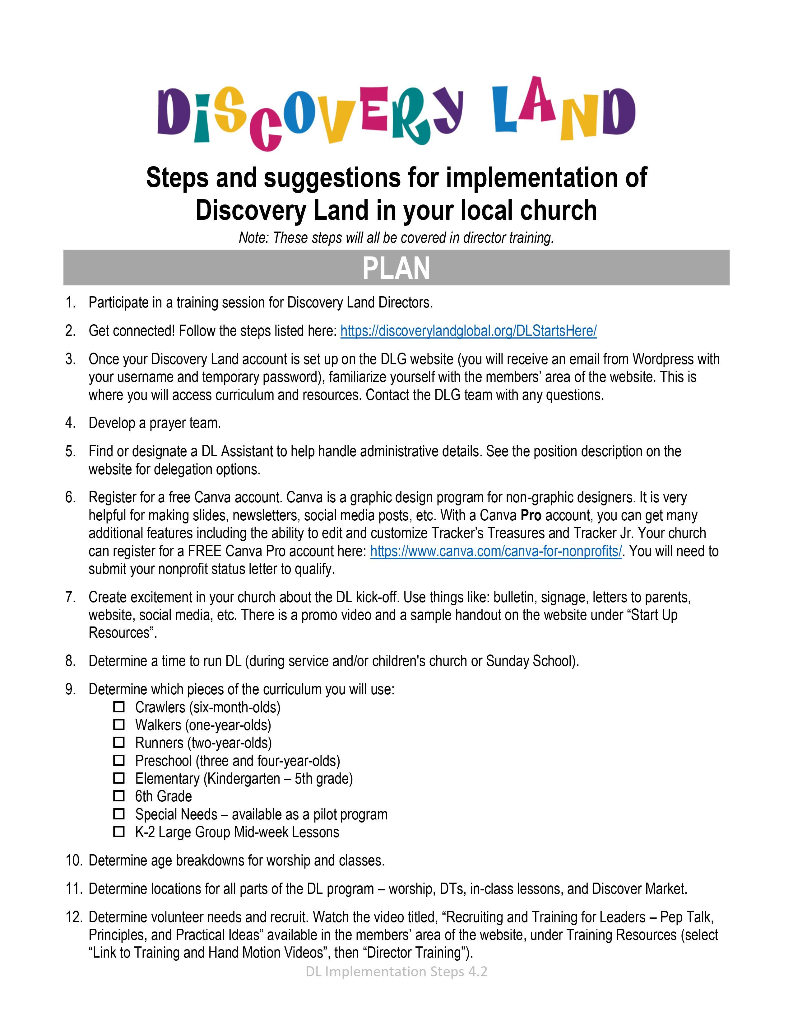
Implementation
Steps
Implementation steps are listed on the document titled
“DL Implementation Steps” available on the website

Slide 78
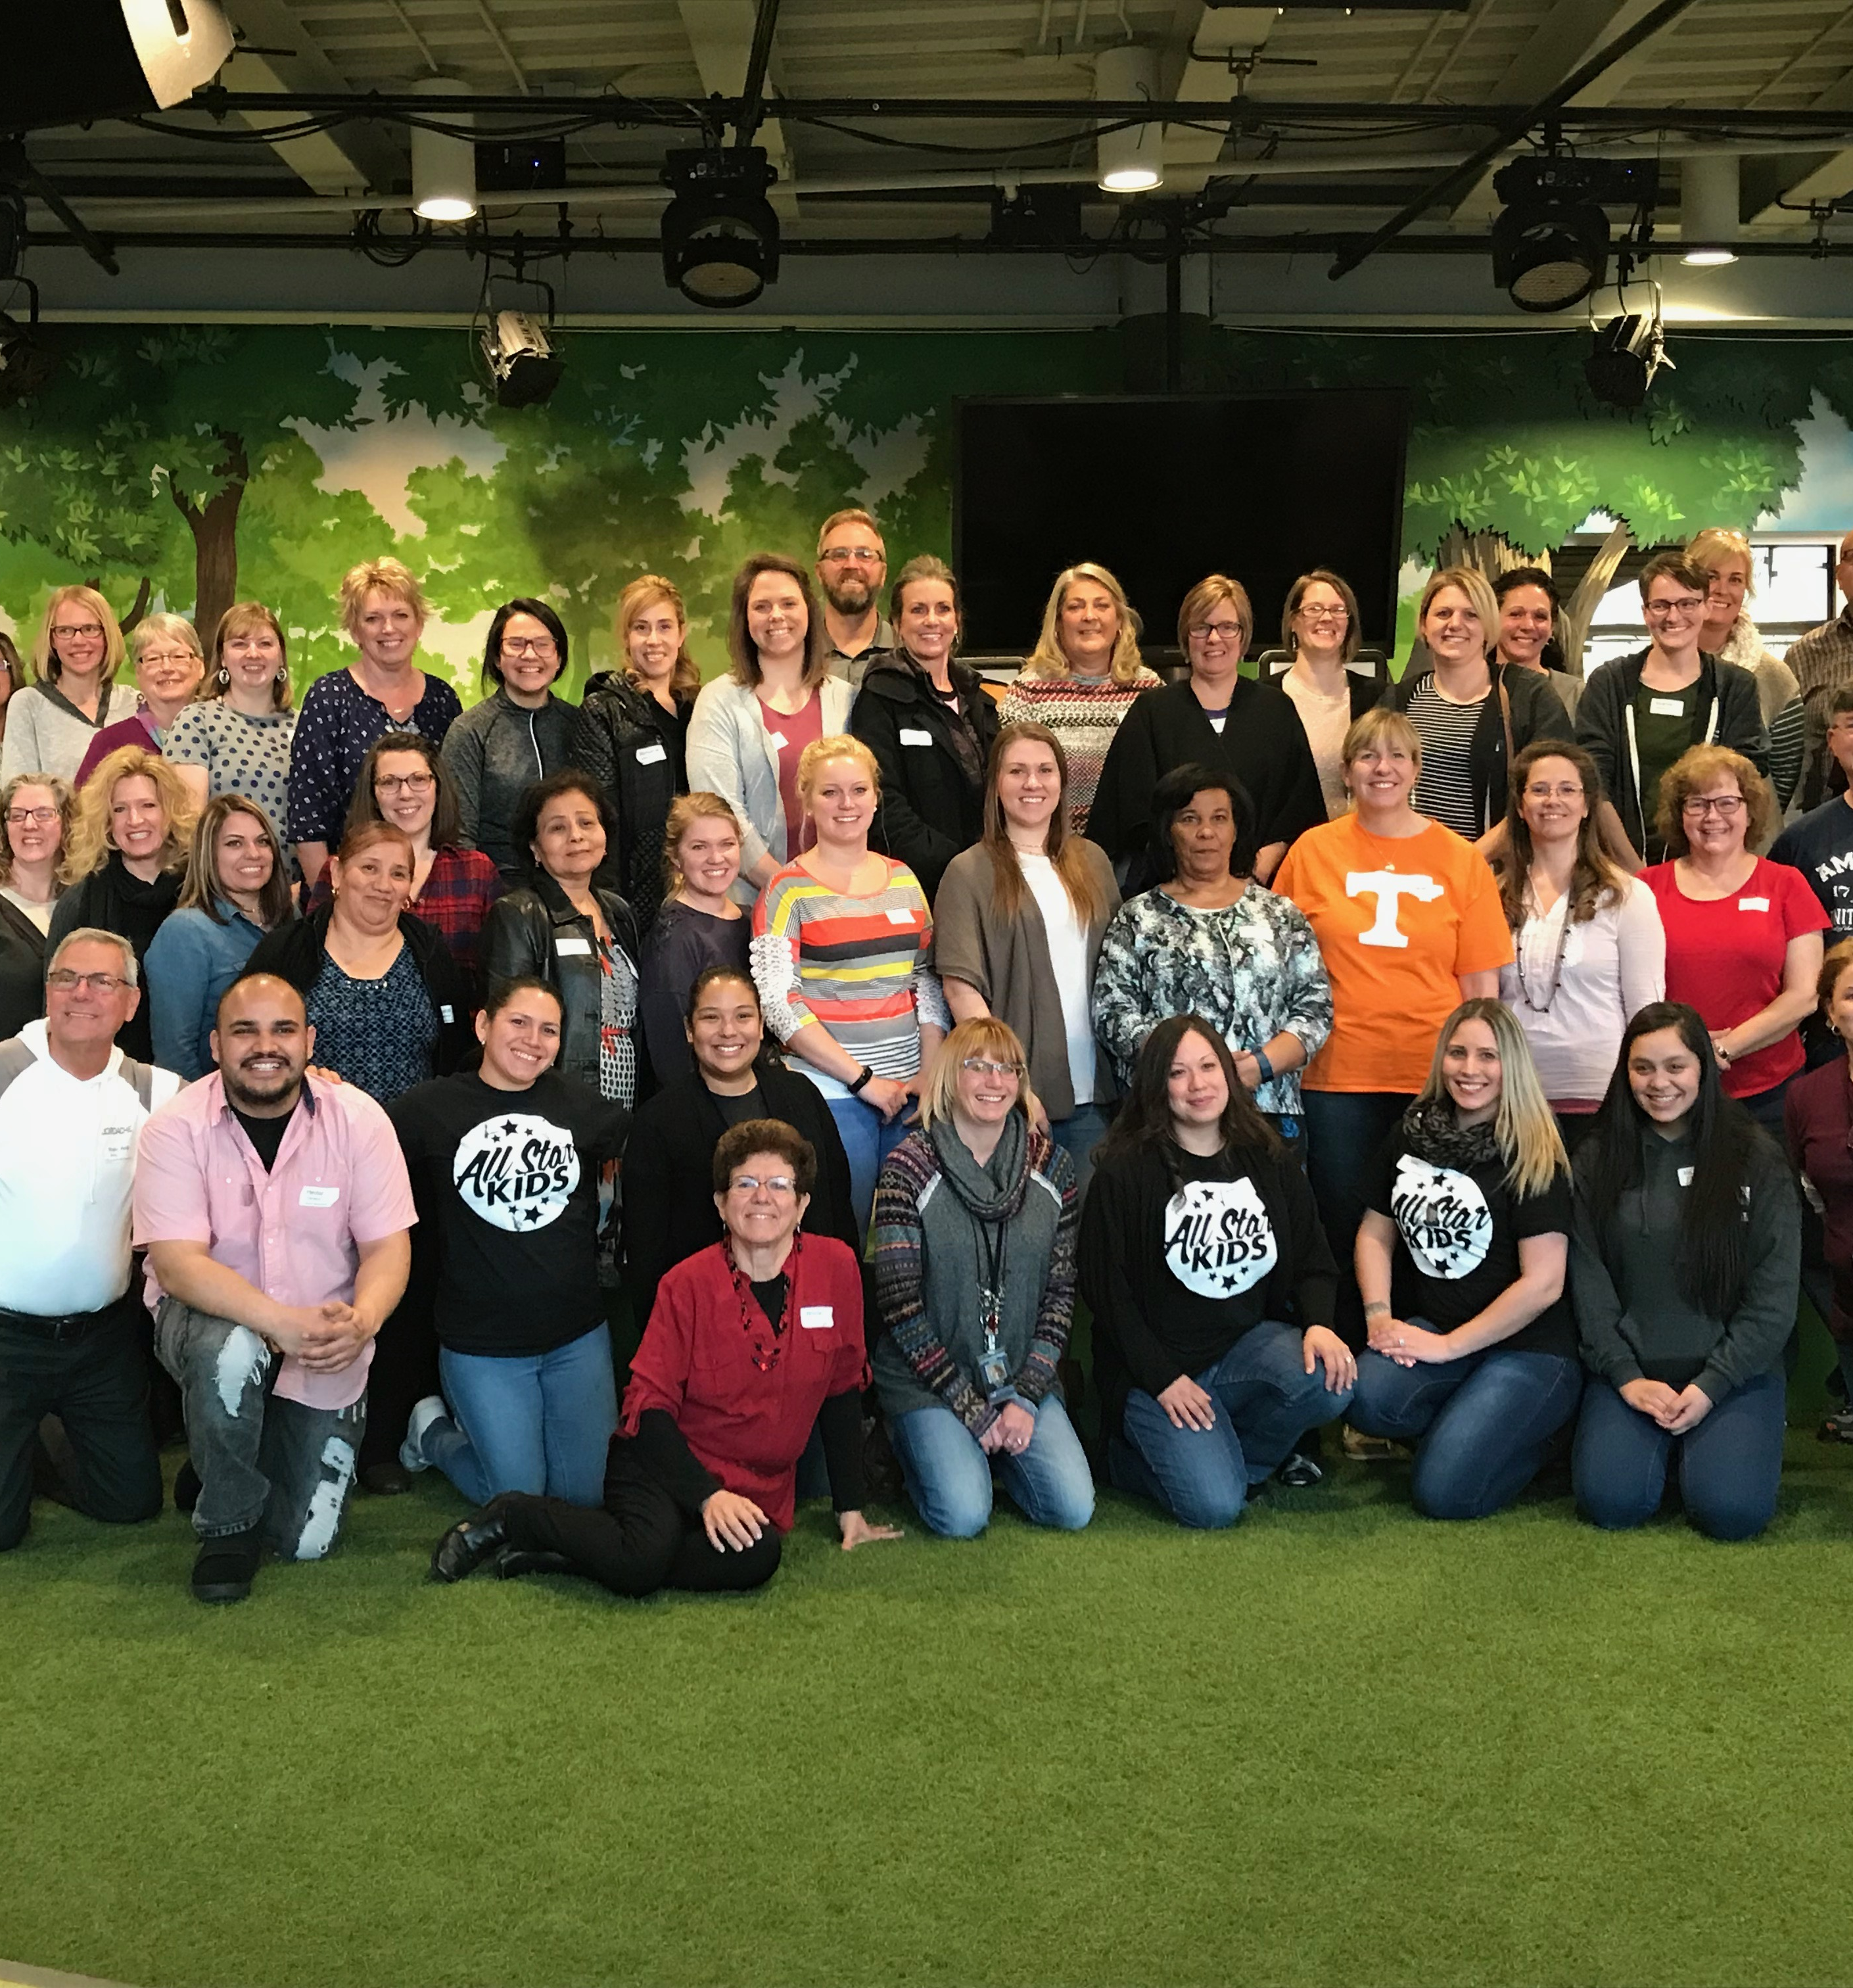
Training Your Team
Set a date (train once per year minimum, ideally twice)
Invite your volunteers – “This is required training for all leaders; if you have an unavoidable conflict, please let me know so we can make alternate training arrangements for you.”
Determine the maximum amount of time that you have

Slide 79

Training Your Team
Determine what resources you’ll use:
Tip: use the DL Kickoff Training Planning Packet
*Volunteer Basics Manual
*DL Basic Training PowerPoint
*Live demo team
*Video demonstration lessons
*Live trainer(s)
*Video training (some available)
Invite and equip trainers

Slide 80


Training Your Team
Gather supplies
Honor your leaders with your set up (atmosphere and food)
Remind your volunteers

